Slide 1
My London best
Made by: Ivana Royachka

Slide 2
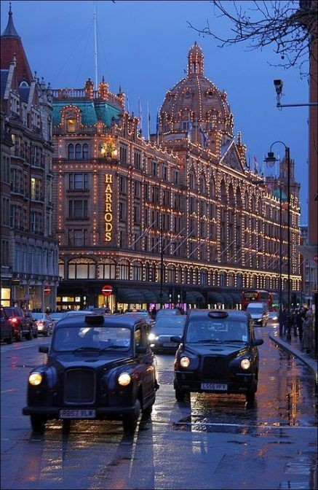
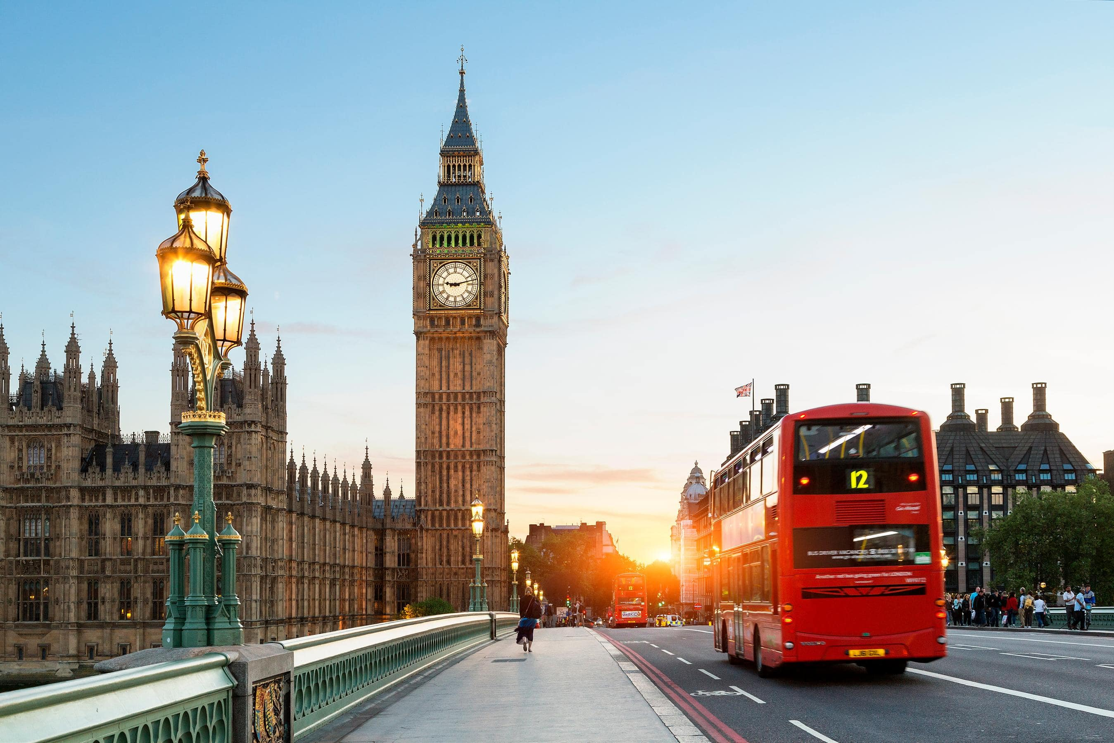
London
London is considered to be one of the world‘s most important global cities and has been termed the world‘s most powerful, most desirable, most visited, most expensive and most popular for work city. London ranks 26th out of 300 major cities for economics performance. It‘s one of the largest financial centres.

Slide 3
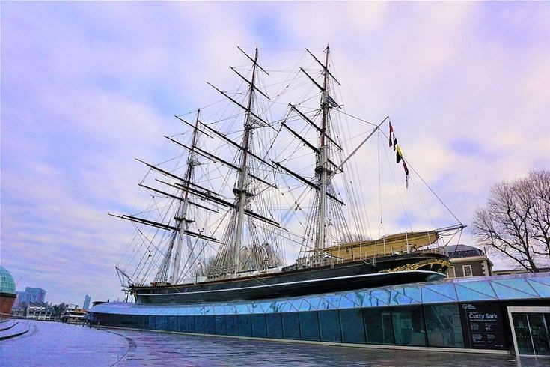
Cutty sark
Cutty sark is listed by National Historic Ships as part of the National Historic Fleet. She is one of only three remaining original composite construction. The ship has been damaged by fire twice in recent years, first on 21 May 2007. She was restored and reopened to the public on 25 April 2012.

Slide 4
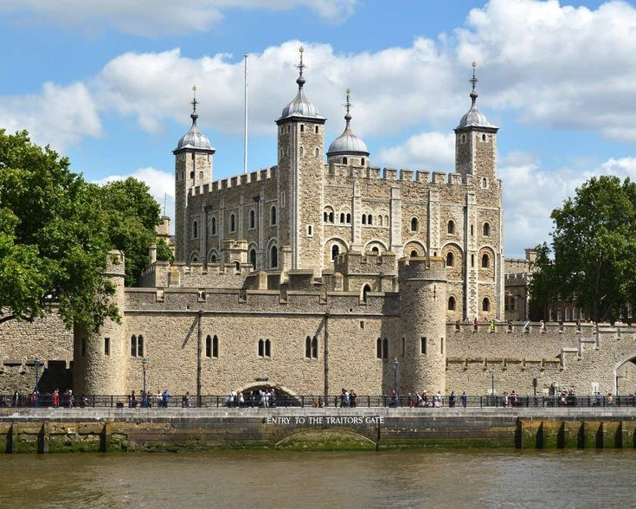
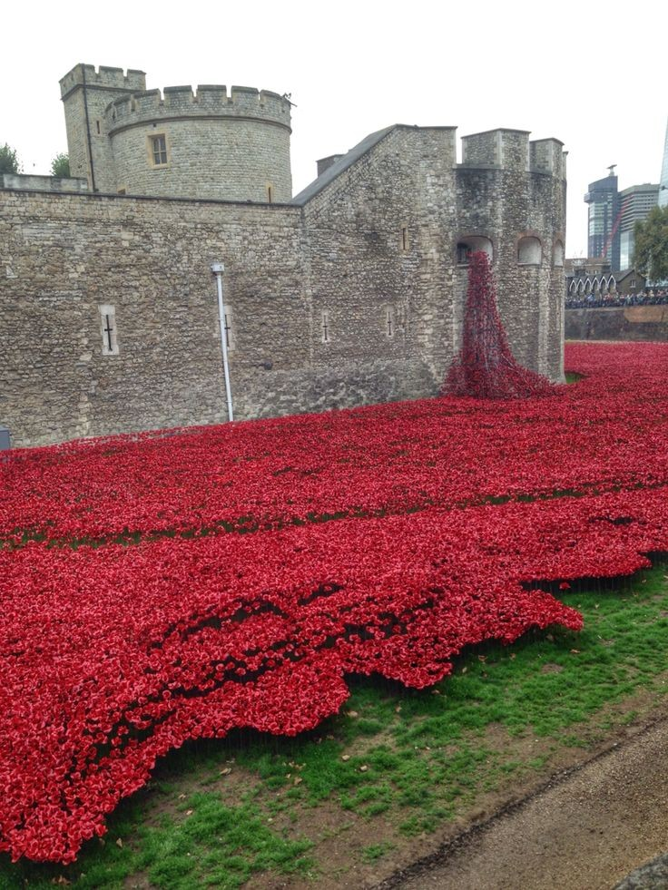
Tower of London
The tower of London has played a prominent role in English history. The tower has served as an armory, a treasury, a menagerie, the home of the Royal Mint, and the home of the Crown Jewels of England. The peak period of the castle‘s use as a prison was the 16th and 17th centuries, when many figures who had fallen into disgrace such as Elizabeth I.

Slide 5
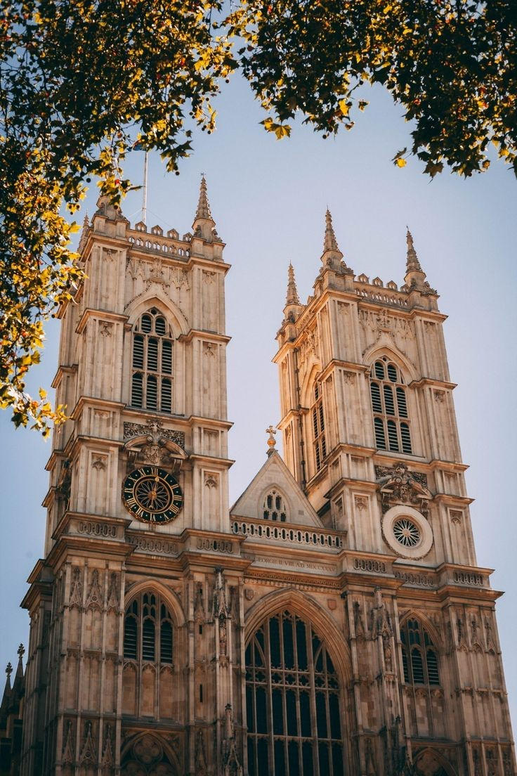
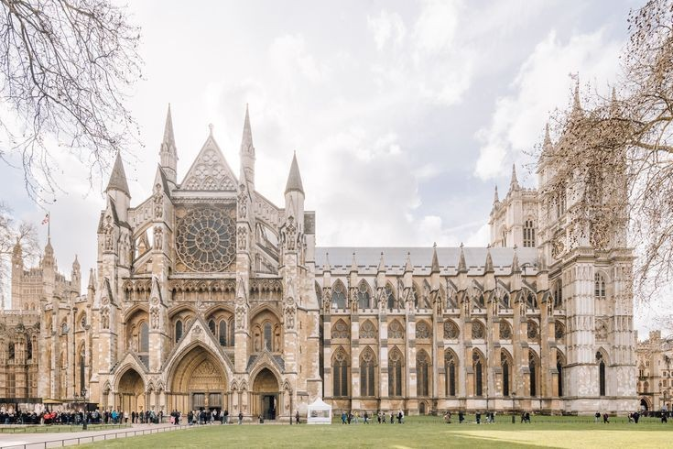
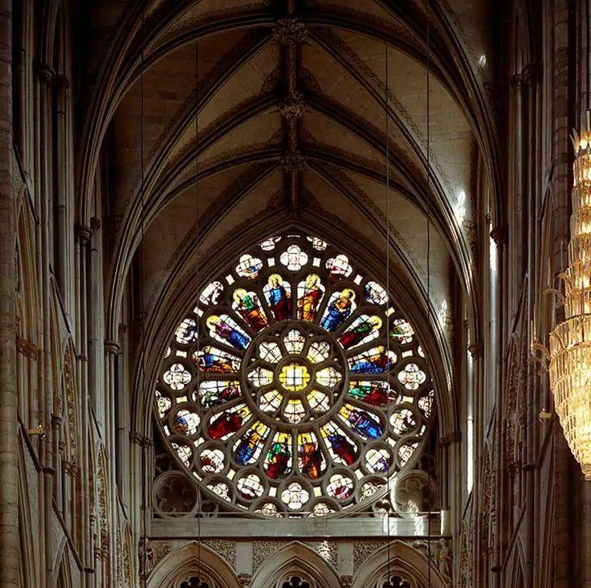
Westminster abbey
Westminster abbey, formally titled as Collegiate Church of Saint Peter at Westminster is in the city Westminster, London, England. Since the coronation of William the Conqueror in 1066, all coronations of British monarchs have been in Westminster abbey. There have been 16 royal weddings at the abbey since 1100

Slide 6
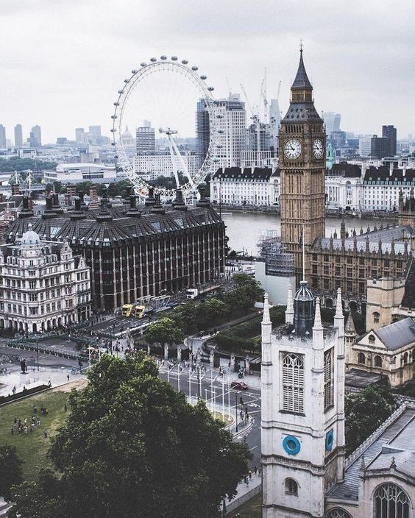
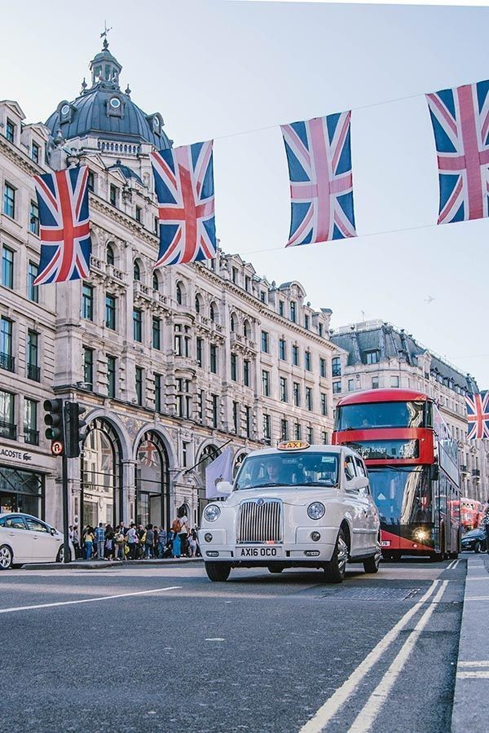
Thank you for your attention

