Slide 1
Westminster Abbey
Performed by Yoanna Petkova

Slide 2
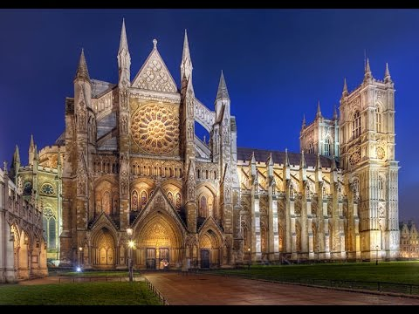
IMAGE

Slide 3
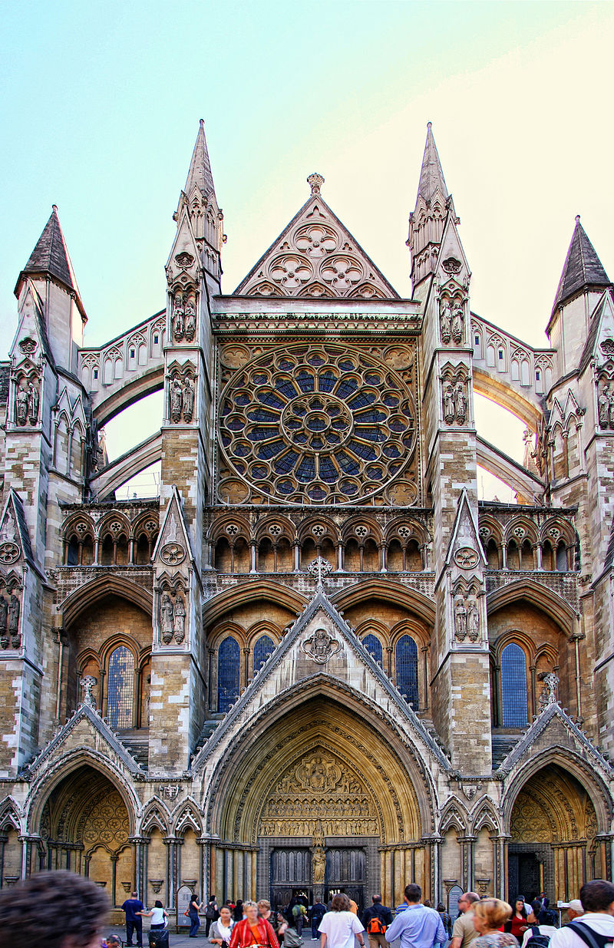
North entrance of Westminster Abbey

Slide 4
History
Between 1042 and 1052 King Edward the Confessor began rebuilding St Peter's Abbey to provide himself with a royal burial church. It was the first church in England built in the Romanesque style.
The building was not completed until around 1090 but was consecrated on 28 December 1065, only a week before Edward's death on 5 January 1066.
A week later he was buried in the church, and nine years later his wife Edith was buried alongside him. His successor, Harold II, was probably crowned in the abbey, although the first documented coronation is that of William the Conqueror later the same year.

Slide 5
Construction of the present church
Construction of the present church was begun in 1245 by Henry III who selected the site for his burial.
The Abbey became the coronation site of Norman Kings.
1540–1550: 10 years as a cathedral
The abbey was restored to the Benedictines under the Catholic Mary I of England, but they were again ejected under Elizabeth I in 1559. In 1560, Elizabeth re-established Westminster as a "Royal Peculiar" – a church of the Church of England responsible directly to the Sovereign, rather than to a diocesan bishop – and made it the Collegiate Church of St Peter (that is, a non-cathedral church with an attached chapter of canons, headed by a dean.) The last of Mary's abbots was made the first dean.
1722–1745: Western towers constructed.
Until the 19th century, Westminster was the third seat of learning in England, after Oxford and Cambridge.
Westminster suffered minor damage during the Blitz on 15 November 1940.
On 6 September 1997, the funeral of Diana, Princess of Wales, was held at the Abbey. On 17 September 2010, Pope Benedict XVI became the first pope to set foot in the abbey.

Slide 6
Coronations
Since the coronations in 1066 of both King Harold and William the Conqueror, coronations of English and British monarchs were held in the abbey.
In 1216, Henry III was unable to be crowned in London when he first came to the throne, because the French prince Louis had taken control of the city, and so the king was crowned in Gloucester Cathedral. This coronation was deemed by the Pope to be improper, and a further coronation was held in the abbey on 17 May 1220.
King Edward's Chair(or St Edward's Chair), the throne on which English and British sovereigns have been seated at the moment of coronation, is housed within the abbey and has been used at every coronation since 1308. From 1301 to 1996 (except for a short time in 1950 when it was temporarily stolen by Scottish nationalists), the chair also housed the Stone of Scone upon which the kings of Scots are crowned. Although the Stone is now kept in Scotland, in Edinburgh Castle, at future coronations it is intended that the Stone will be returned to St Edward's Chair for use during the coronation ceremony.

Slide 7
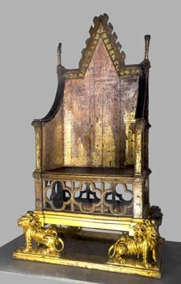
King Edward's Chair

Slide 8
Royal weddings
11 of November 1100: King Henry I of England was married to Matilda of Scotland
9 April 1269: Edmund of Crouchback, 1st Earl of Leicester and Lancaster, son of King Henry III was married to Lady Aveline de Forz
8 July 1290: Margaret of England, daughter of King Edward I, was married to John II, son of Duke of Brabant
20 January 1382: King Richard II of England was married to Anne of Bohemia
27 February 1919: Princess Patricia of Connaugt was married to Capt the Hon Alexander Ramsay
28 February 1922: The Princess Mary, daughter of King George V, was married to Viscount Lascelles
20 November 1947: Princess Elizabeth (now Queen Elizabeth II), elder daughter of King George VI, was married to the Duke of Edinburgh
29 April 2011: Prince William, Duke of Cambridge, grandson of Queen Elizabeth II, was married to Miss Catherine Middleton

Slide 9
Schools
Westminster School and Westminster Abbey Choir School are also in the precincts of the abbey. It was natural for the learned and literate monks to be entrusted with education, and Benedictine monks were required by the Pope to maintain a charity school in 1179. The Choir School educates and trains the choirboys who sing for services in the Abbey.

Slide 10
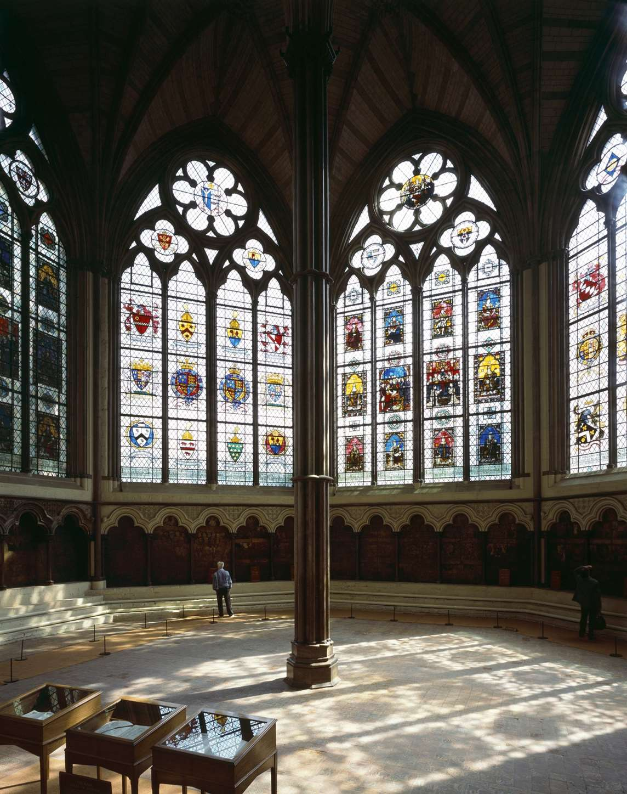
The Chapter house
The chapter house was built concurrently with the east parts of the abbey under Henry III, between about 1245 and 1253.It was restored by Sir George Gilbert Scott in 1872. The entrance is approached from the east cloister walk and includes a double doorway with a large tympanum above.

