Slide 1
Canterbury
Venelin Portarski

Slide 2
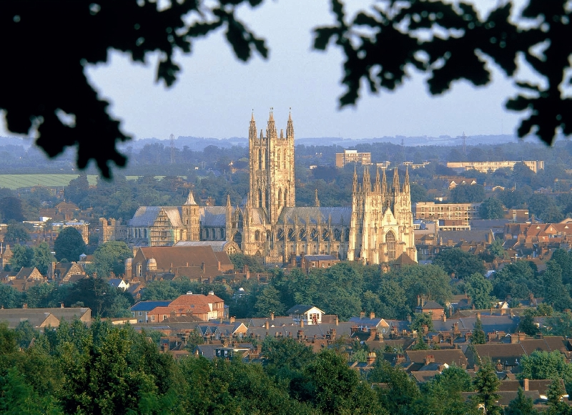
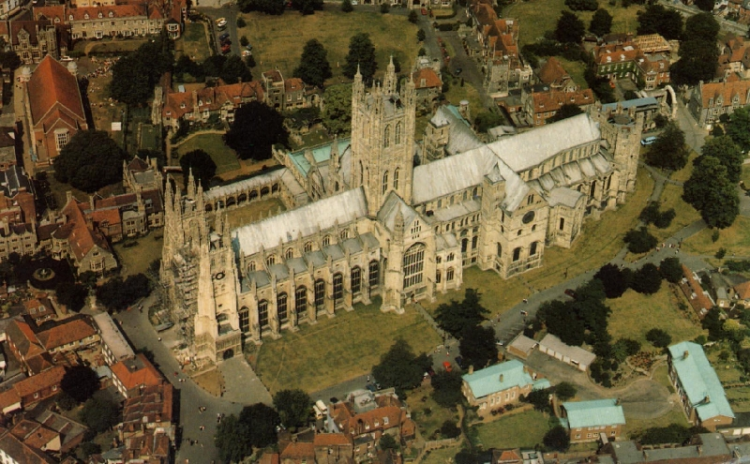
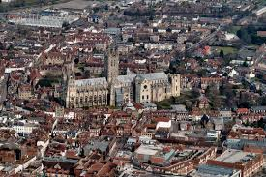
Canterbury (Listeni/ˈkæntəbri/, /-bəri/, or /-bɛri/ is a historic English cathedral city and UNESCO World Heritage Site, which lies at the heart of the City of Canterbury, a local government district of Kent, England. It lies on the River Stour.

Slide 3
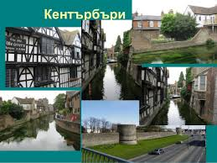
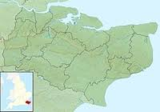
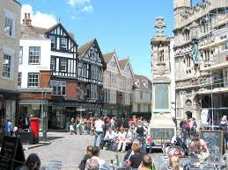
The Canterbury area has been inhabited since prehistoric times. Lower Paleolithic axes, and Neolithic and Bronze Age pots have been found in the area.Canterbury was first recorded as the main settlement of the Celtic tribe of the Cantiaci, which inhabited most of modern-day Kent. In the 1st century AD, the Romans captured the settlement and named it Durovernum Cantiacorum.The Romans rebuilt the city, with new streets in a grid pattern, a theatre, a temple, a forum, and public baths. Although they did not maintain a major military garrison, its position on Watling Street relative to the major Kentish ports of Rutupiae (Richborough), Dubrae (Dover), and Lemanae (Lymne) gave it considerable strategic importance.

Slide 4
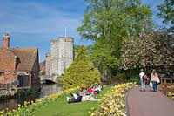
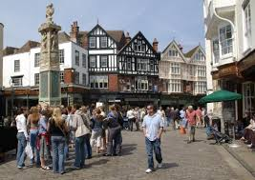
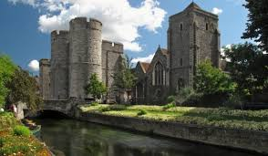
In 842 and 851, Canterbury suffered great loss of life during Danish raids. In 978, Archbishop Dunstan refounded the abbey built by Augustine, and named it St Augustine's Abbey. A second wave of Danish attacks began in 991, and in 1011 the cathedral was burnt and Archbishop Alphege was killed in 1012. Remembering the destruction caused by the Danes, the inhabitants of Canterbury did not resist William the Conqueror's invasion in 1066.

Slide 5
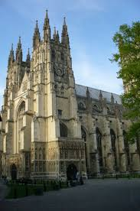
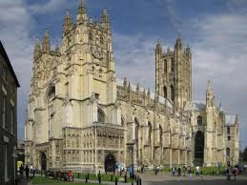
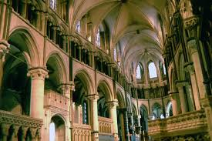
By the 17th century, Canterbury's population was 5,000; of whom 2,000 were French-speaking Protestant Huguenots, who had begun fleeing persecution and war in the Spanish Netherlands in the mid-16th century. The Huguenots introduced silk weaving into the city, which by 1676 had outstripped wool weaving

Slide 6
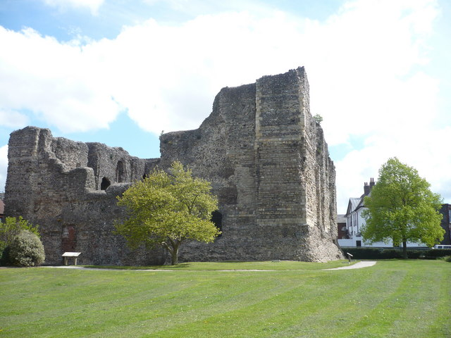
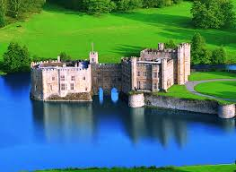
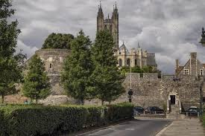
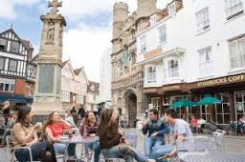
By 1770, the castle had fallen into disrepair, and many parts of it were demolished during the late 18th century and early 19th century.

Slide 7
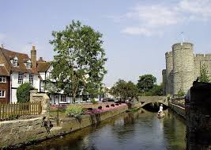
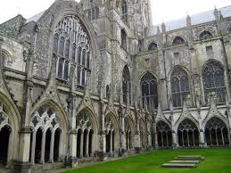
During the First World War, a number of barracks and voluntary hospitals were set up around the city, and in 1917 a German bomber crash-landed near Broad Oak Road. During the Second World War, 10,445 bombs dropped during 135 separate raids destroyed 731 homes and 296 other buildings in the city, including the missionary college and Simon Langton Girls' Grammar Schools, and 115 people were killed. The most devastating raid was on 1 June 1942 during the Baedeker Blitz.

