Slide 1
University of Oxford

Slide 2
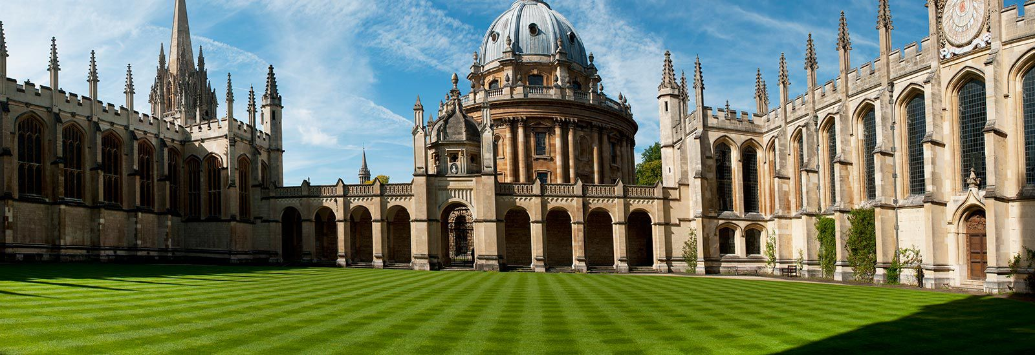
History
The University of Oxford (Oxford) is a university located in Oxford, United Kingdom.
The University of Oxford is the oldest university in the English-speaking world. There is no clear date of foundation, but teaching existed at Oxford in some form in 1096.

Slide 3
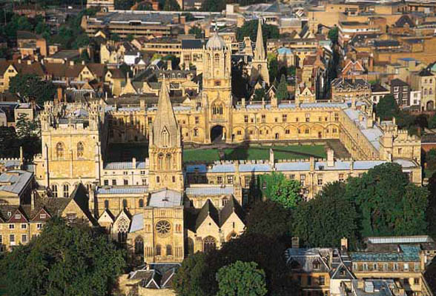
Organization and governance
Oxford consist of Central University and 38 colleges which are self-governing and financially independent institutions.
The central University is composed of academic departments and research centers, administrative departments, libraries and museums.

Slide 4
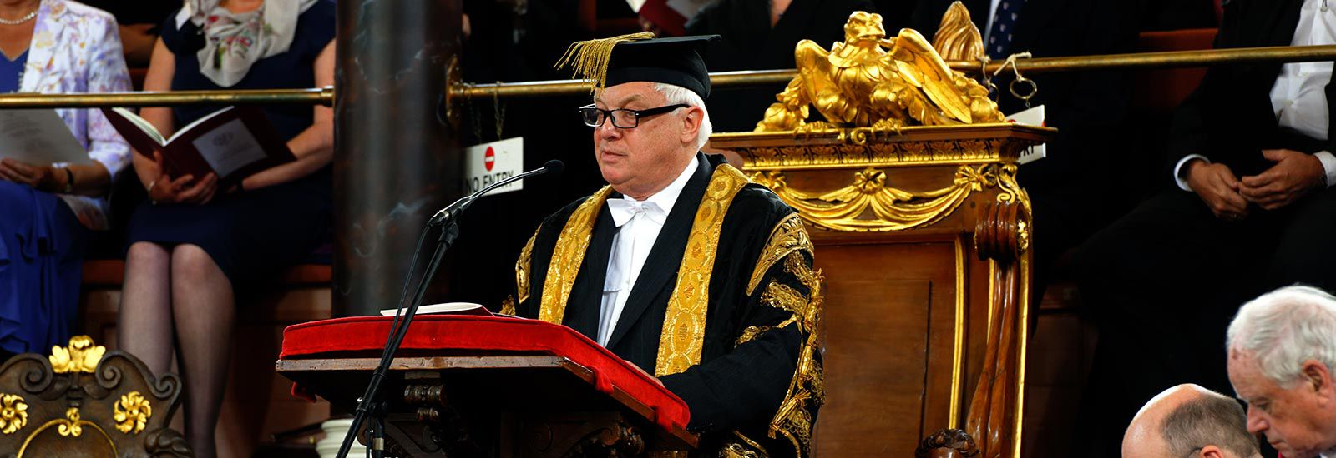
Organization and governance
The university's formal head is the Chancellor, currently Lord Patten of Barnes. The Chancellor is a titular figure, and is not involved with the day-to-day running of the university.

Slide 5
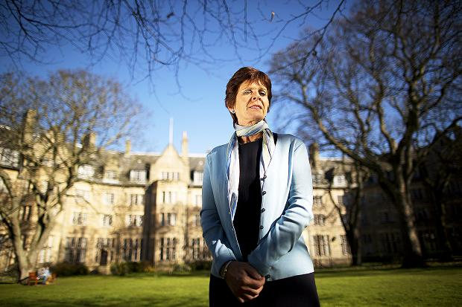
Organization and governance
The central administration of the University is headed by the Vice-Chancellor, currently Louise Richardson. The vice-chancellors have specific responsibilities for education, research, planning and resources, development and external affairs.

Slide 6
Organization and governance
The various academic faculties, departments, and institutes are organized into four divisions, each with its own head and elected board. They are the Humanities division, the Social Sciences Division, the Mathematical, Physical and Life Sciences Division and the Medical Sciences Division.

Slide 7
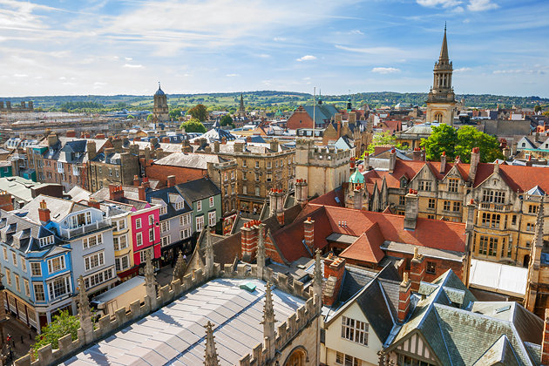
Organisation and governance
The university is a "city university“. It does not have a main campus. Instead, colleges, departments, accommodation, and other facilities are scattered throughout the city centre.

Slide 8
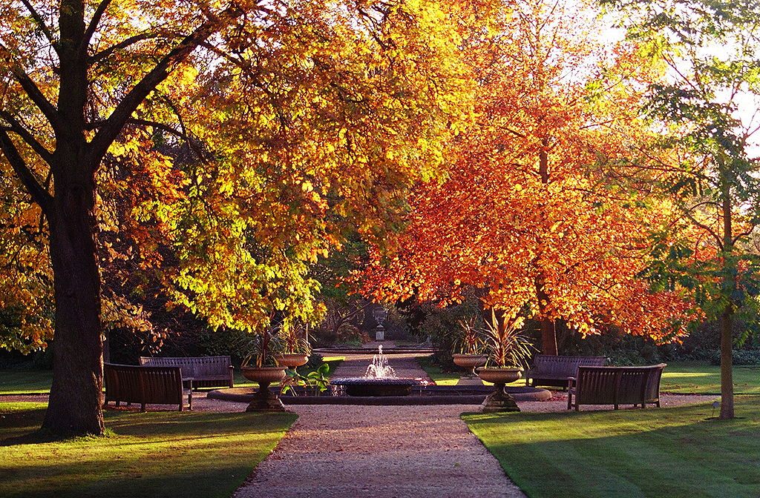
Organization and governance
There are also a big parks in Oxford. As well as providing gardens and exotic plants, the Parks contains numerous sports fields.
The Botanic Garden on the High Street, for example, is the oldest botanic garden in the UK.

Slide 9
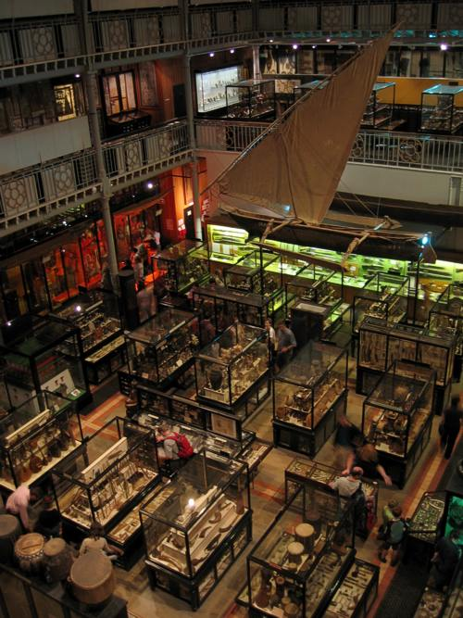
Organization and governance
Oxford maintains a number of museums and galleries, open for free to the public. The Ashmolean Museum, founded in 1683, is the oldest museum in the UK, and the oldest university museum in the world.

Slide 10
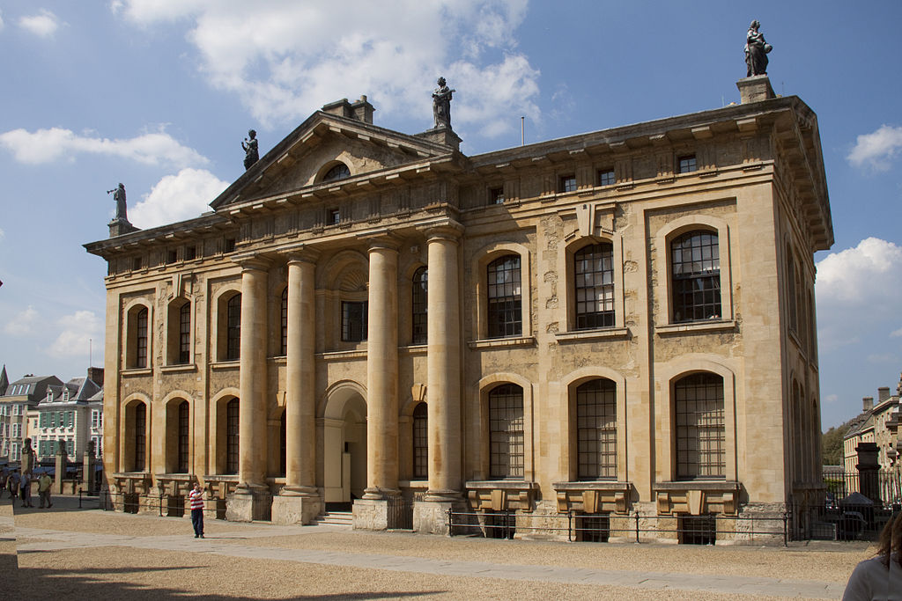
The university of Oxford maintains the largest university library system in the UK , with over 11 million volumes housed on190 km of shelving, the Bodleian group is the second-largest library in the UK.

