Slide 1
University of Cambridge

Slide 2
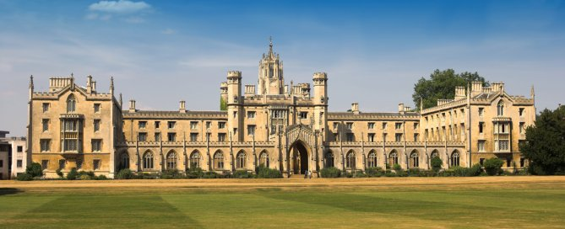
University of Cambridge
The University of Cambridge is a collegiate public research university in Cambridge, England. Founded in 1209 and given royal charter status by King Henry III in 1231, Cambridge is the second-oldest university in the English-speaking world and the world's fourth-oldest surviving university.

Slide 3
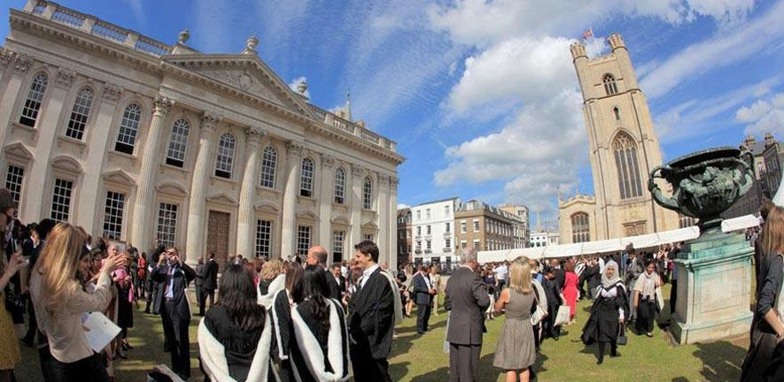
Cambridge
Cambridge is formed from a variety of institutions which include 31 constituent colleges and over 100 academic departments organised into six schools. Cambridge University Press, a department of the university, is the world's oldest publishing house and the second-largest university press in the world

Slide 4
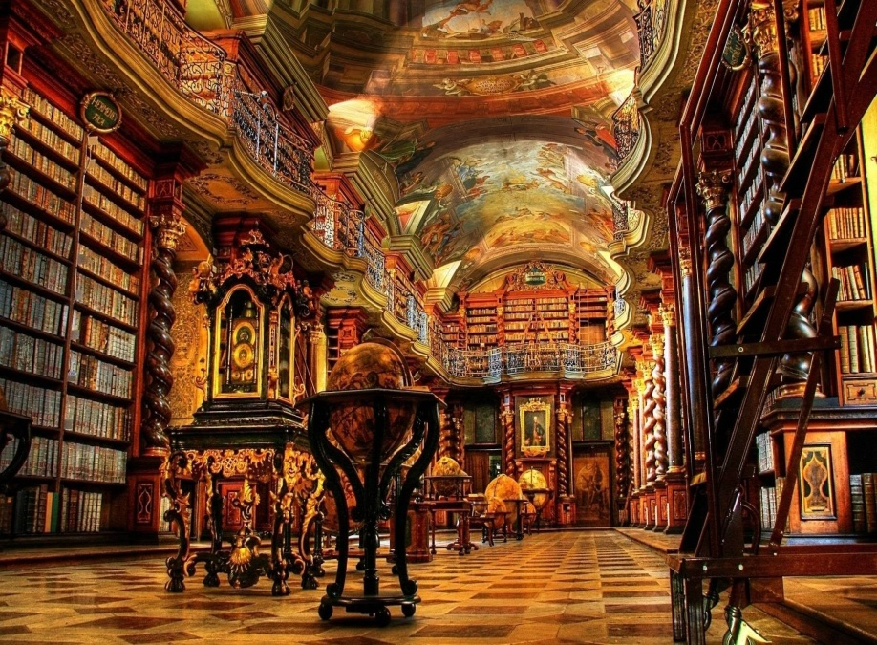
Library
The university also operates eight cultural and scientific museums, including the Fitzwilliam Museum, and a botanic garden. Cambridge's libraries hold a total of around 15 million books, eight million of which are in Cambridge University Library, a legal deposit library.

Slide 5
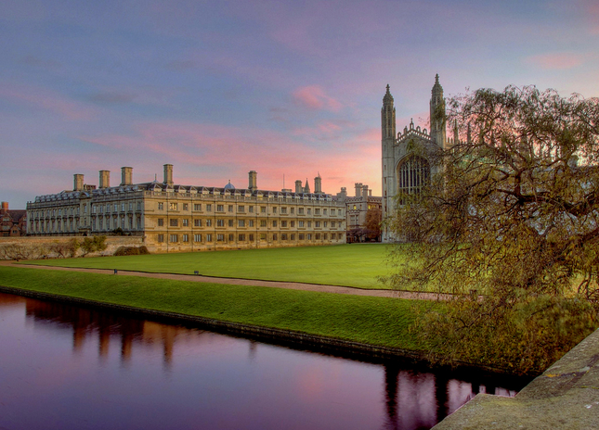
Foundation of the colleges
The central university and colleges have a combined endowment of around £5.89 billion, the largest of any university outside the United States. The university is closely linked with the development of the high-tech business cluster known as "Silicon Fen". It is a member of numerous associations and forms part of the "golden triangle" of leading English universities and Cambridge University Health Partners, an academic health science centre.

Slide 6
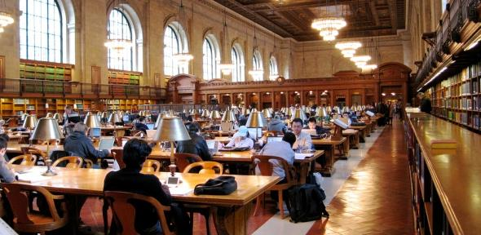
Science
Cambridge is consistently ranked as one of the world's best universities.The university has educated many notable alumni, including eminent mathematicians, scientists, politicians, lawyers, philosophers, writers, actors, and foreign Heads of State.

Slide 7
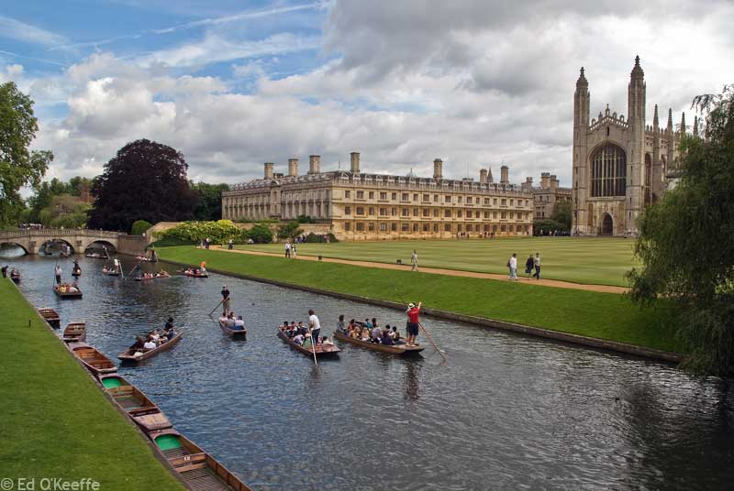
Academic profile
Ninety-five Nobel laureates, two Chief Scientists of the U.S. Air Force and ten Fields medalists have been affiliated with Cambridge as students, faculty, staff or alumni.

Slide 8
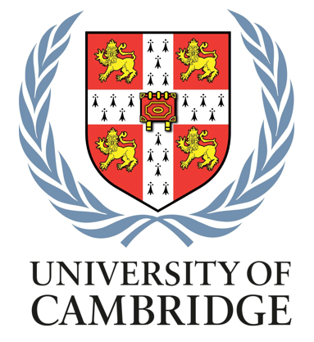
Motto of Cambridge
Motto: From here, light and sacred draughts.

Slide 9
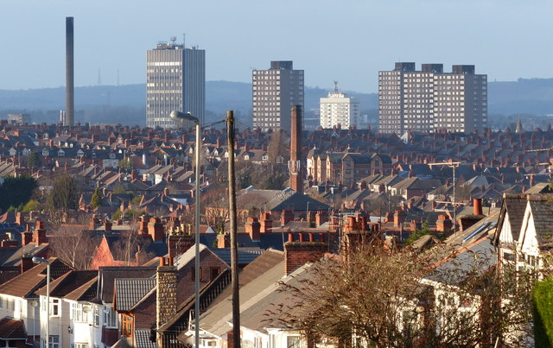
Sites
The university is divided into several sites where the different departments are placed. The main ones are: Addenbrooke's Downing Site
Silver Street/Mill Lane
West Cambridge

Slide 10
The End
Изготвил: Юлия Емилова 8а клас

