Slide 1
Tower castle and tower bridge
Made by yoana dzhelyova

Slide 2
The history of tower castle
the Tower of London is a historic castle located on the north bank of the River Thames in central London.
The White Tower, which gives the entire castle its name, was built by William the Conqueror in 1078.

Slide 3
Architecture
In the centre of the Tower was build the white tower.
Height
Area
VISITORS

Slide 4
Tourism
The Tower of London has become one of the most popular tourist attractions in the country.

Slide 5
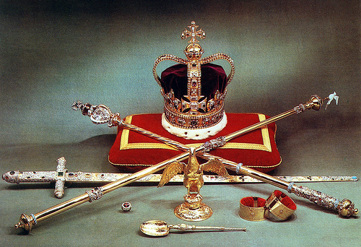
The tower as an attraction
Crown jewels
Today, the crown jewels are one of the most popular attractions at the Tower of London.

Slide 6
The perfect garden
The poppy garden in the yard of the tower castle
From what Is the garden made?
How many are the poppies?
How is the garden called and why?
volunteers

Slide 7
Tower bridge - history
The bridge crosses the River Thames close to the Tower of London and has become an iconic symbol of London.

Slide 8
architecture
Construction started in 1886 and took eight years.
Height
area

Slide 9
attractions
the glass floor
Height
visitors

Slide 10
