Slide 1
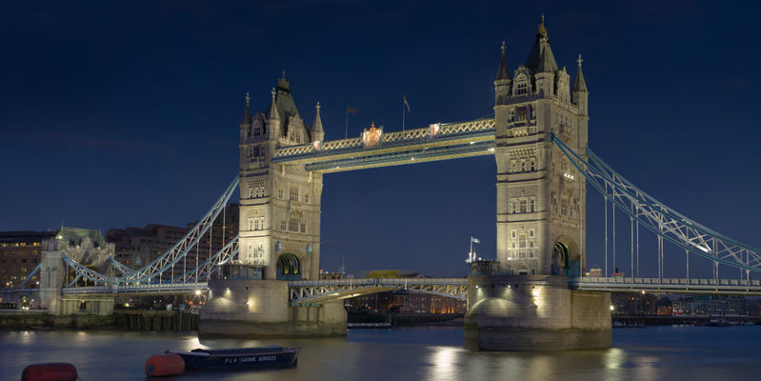
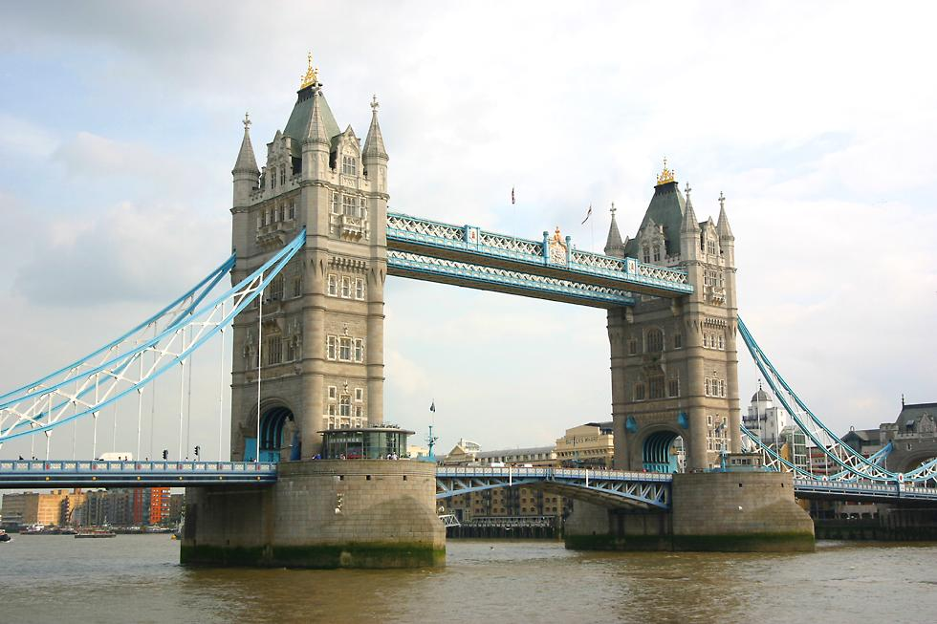
The Tower Bridge

Slide 2
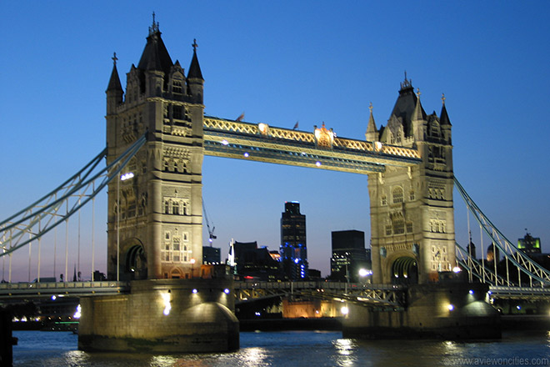
How the Tower Bridge looks
140 feet headway for ships
used about 235,000 cubic feet of cormish granite and Portland stone
20,000 tons of cement
70,000 cubic yards of concrete
31,000,000 bricks
14,000 tons of iron
and steel

Slide 3
How the Tower Bridge is powered
The Tower Bridge was once powered by hydraulic pumps worked by steam until 1976, when electric motors were put into the bridge.
A hydraulic motor is a mechanical actuator that converts hydraulic pressure and flows into torque and angular displacement.

Slide 4
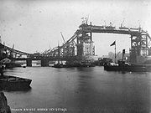
When the Tower Bridge was built
when it was built, the Tower Bridge was the largest and the hardest bascules bridge ever completed.
This type of bridge is known as a "bascule" bridge, drawing on the French word meaning "seesaw," in which the two sections of the roadway could swing upwards to allow a ship to pass through.

Slide 5
Who made the Tower Bridge
Horace Jones died while the bridge was being built. Sir Horace Jones was English
Architect in the 19th century, knighted in 30, July, 1886.
In 1882, architect Horace Jones put forward a design. He hoped to prevent the new bridge from blocking access to the river further west by designing a bridge that could open to allow ships to pass through.
horace jones

Slide 6
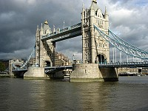
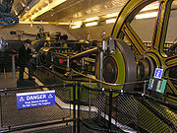
Pictures of the Tower Bridge
http://home.pacbell.net/hywaymn/tower_bridge_history.htm
http://www.ehow.com/about_6655111_fun-london-tower-bridge.html#ixzz1Dx2iHdTi
http://www.absoluteastronomy.com/topics/Stationary_steam_engine.
http://lovinglondonapartments.com/London-Architecture-Tower-Bridge-poi-182-en.html.

Slide 7
How the Tower Bridge looks today
Today, the bascules are still operated by hydraulic power , but since 1976, they have been driven by oil and electricity rather than steam.
. Today you can visit the Tower Bridge exhibition and the high-level walkways between the towers.

Slide 8
The End
By : Kiril Lukarov

