Slide 1
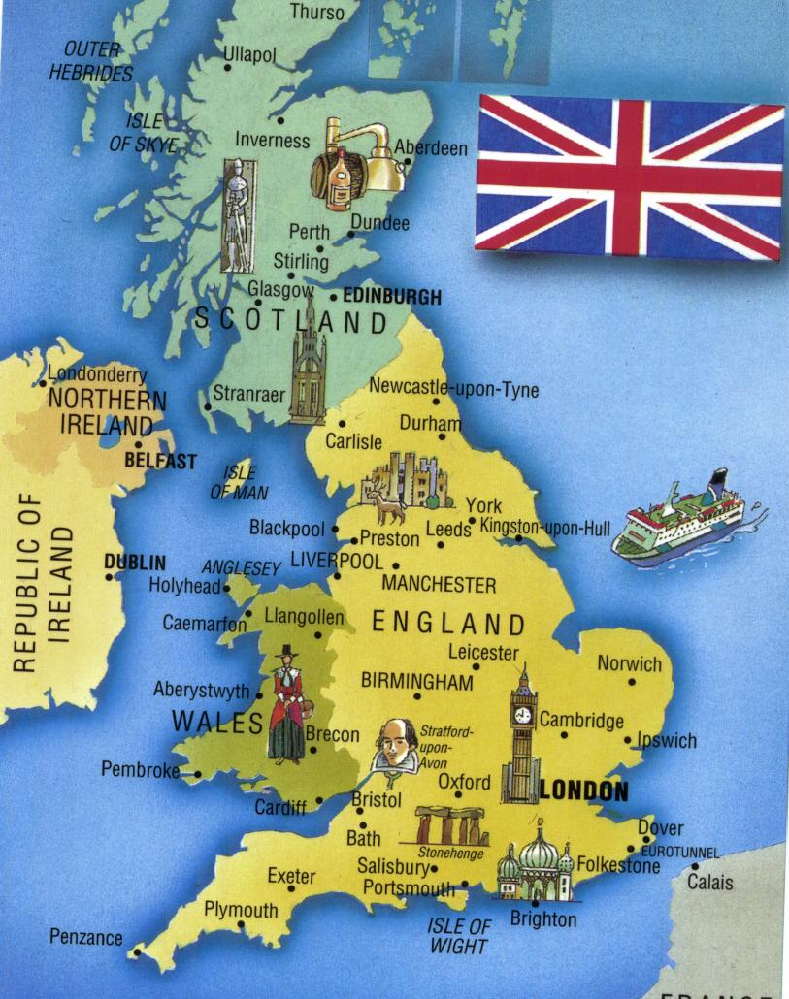
The UK
I would like to visit the United Kingdom

Slide 2
Big Ben
Symbol of the UK
Clock- tower of the Westminster palace
completed in 1859
150th anniversary on 31/05/2009

Slide 3
Trafalgar Square
Public square in the city of Westminster
Battle of Trafalgar(1805)
Christmas ceremony

Slide 4
British Museum
World’s 5th most visited museum
In 2013- 6,7 million visitors
Built in 1848

Slide 5
Buckingham Palace
A royal residence
Located in the city of Westminster
Built in 1837

Slide 6
Windsor Castle
The biggest castle
A royal residence
Built in the 900s

Slide 7
Alnwick Castle
The 2nd biggest castle
In the English country of Northumberland
1st part built in 1096

Slide 8
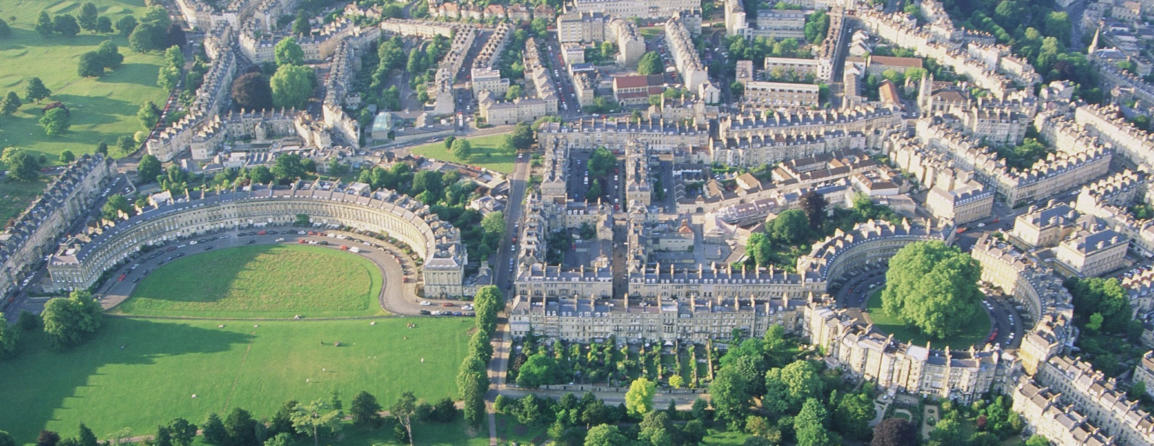
Town Bath
City in the ceremonial country of Somerset, Englamd
Bath Film Festival
Bath Literature Festival

Slide 9
London Eye
On the South Bank of the River Thames
3 000 000 visitors every year
Built in 1999

Slide 10
Disney Land
Opening in 2022

Slide 11
End

