Slide 1
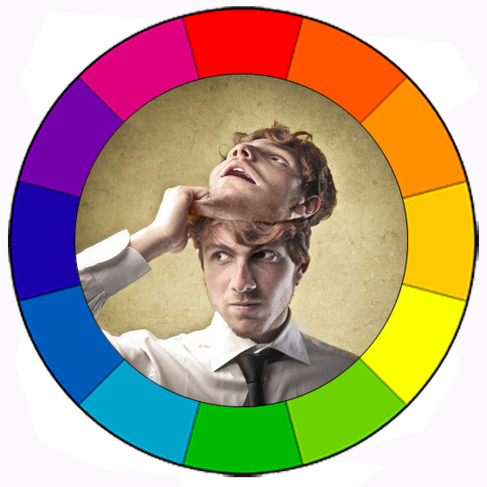
PERSONALITY

Slide 2
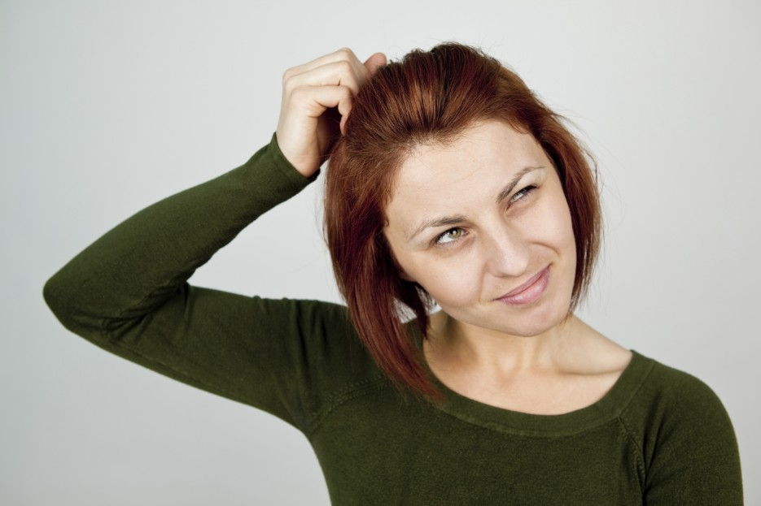
Absent-minded

Slide 3
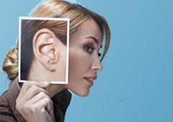
Attentive

Slide 4
Bad-tempered

Slide 5
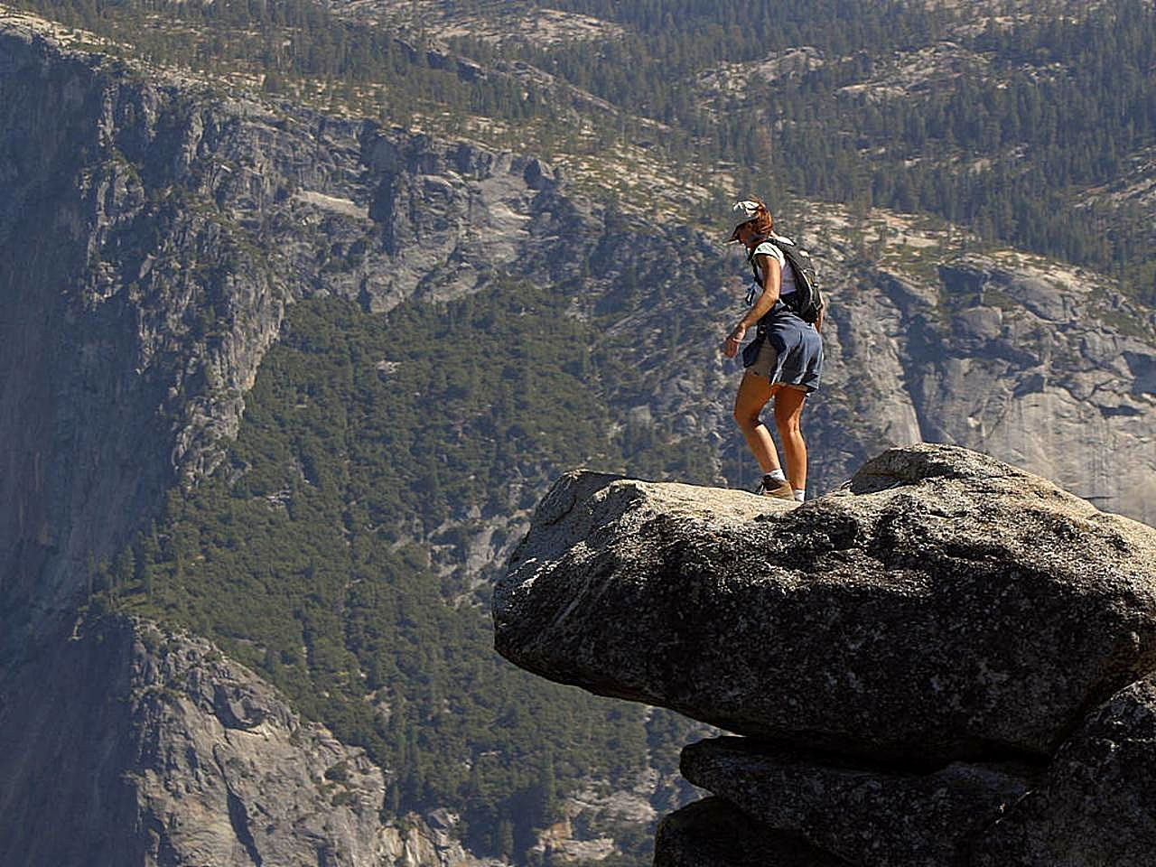
Brave

Slide 6
Boastful

Slide 7
Calm

Slide 8
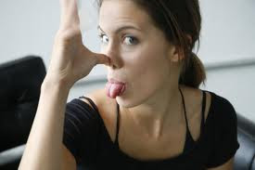
Cheeky

Slide 9
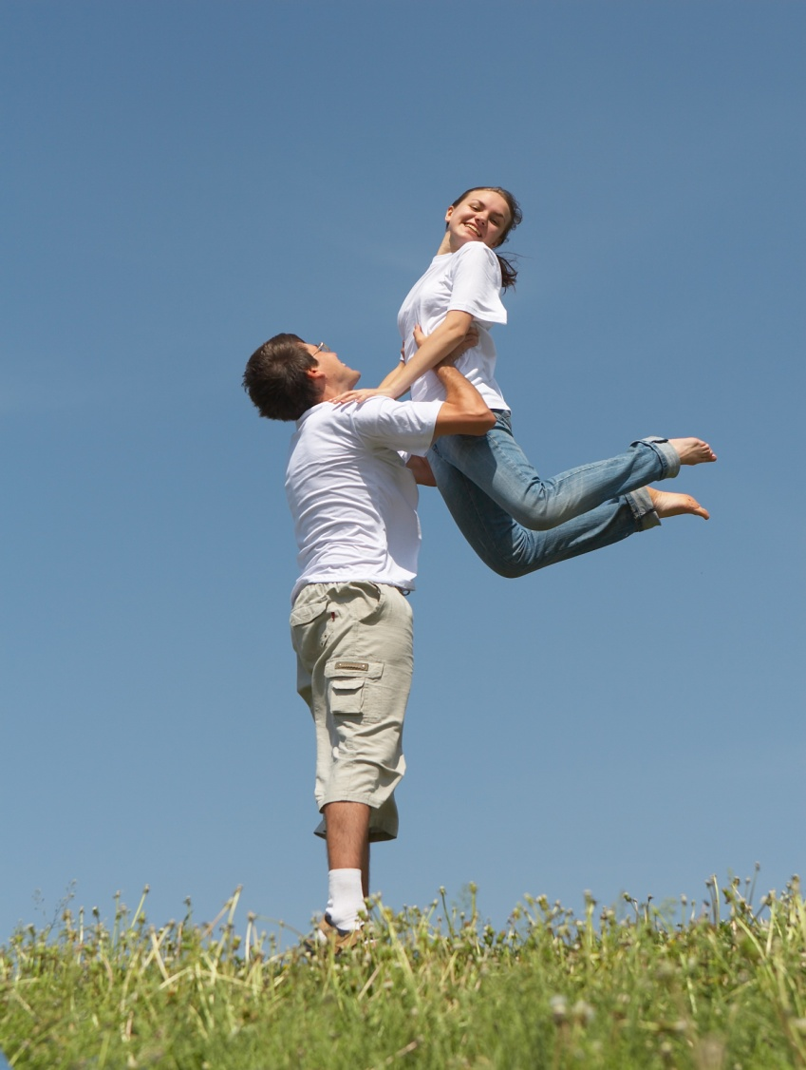
Cheerful

Slide 10
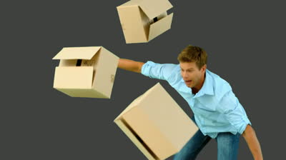
Clumsy

Slide 11
Critical

Slide 12
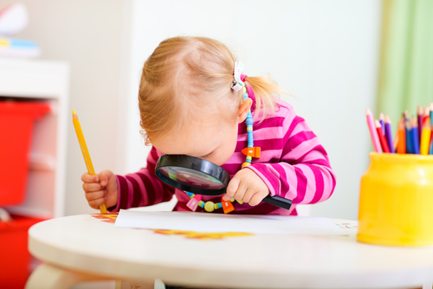
Curious

Slide 13
Determined

Slide 14
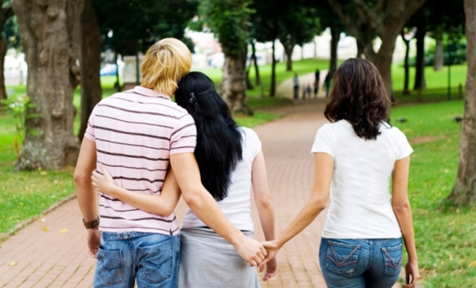
Dishonest

Slide 15
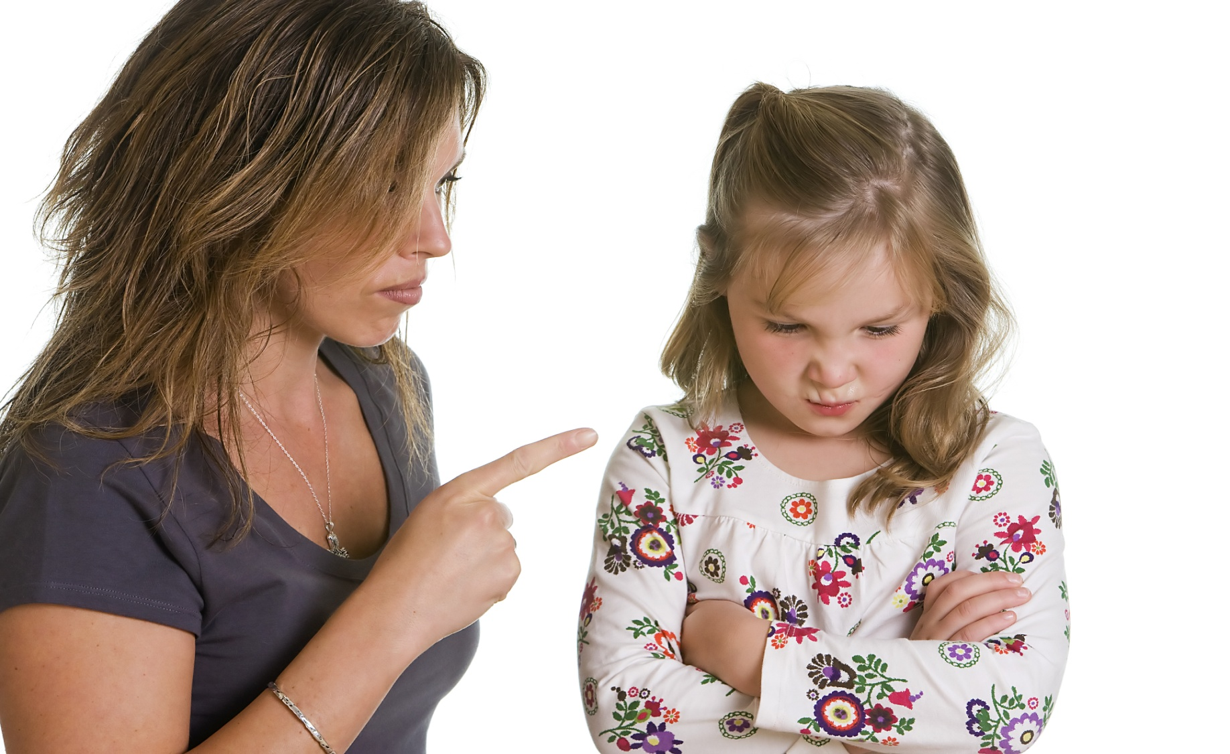
Disobedient

Slide 16
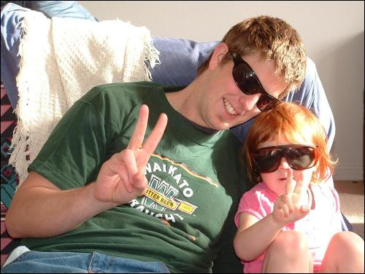
Easy-going

Slide 17
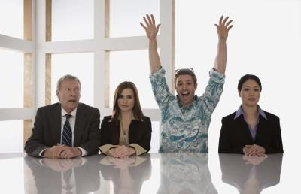
Extrovert

Slide 18
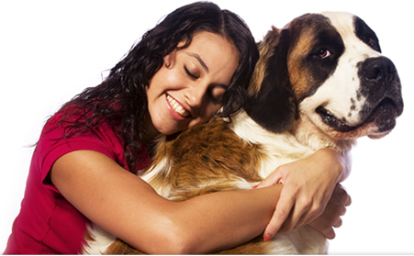
Faithful

Slide 19
Friendly

Slide 20
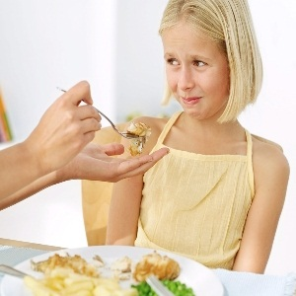
Fussy

Slide 21
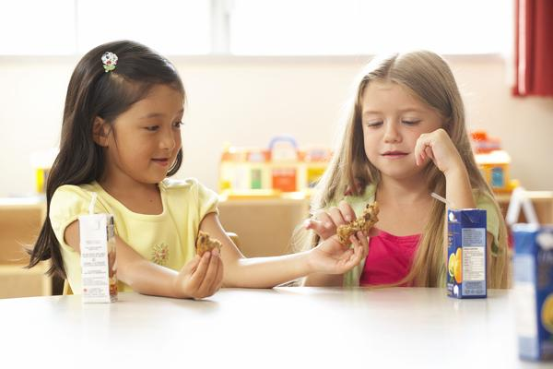
Generous

Slide 22
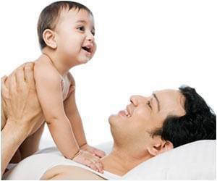
Good-tempered

Slide 23
Gossip

Slide 24
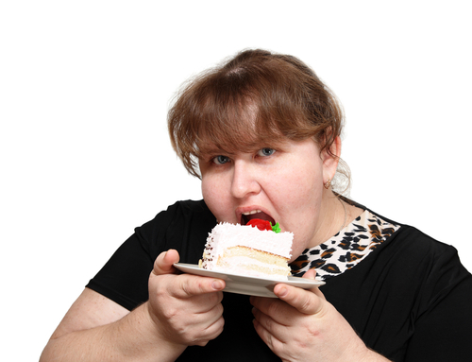
Greedy

Slide 25
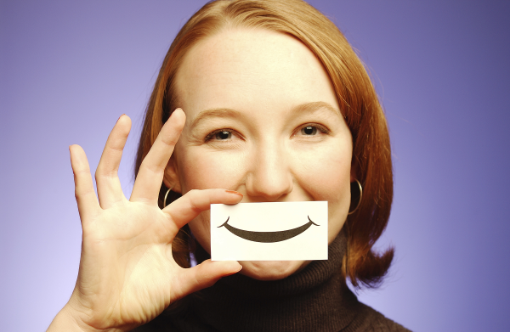
Happy

Slide 26
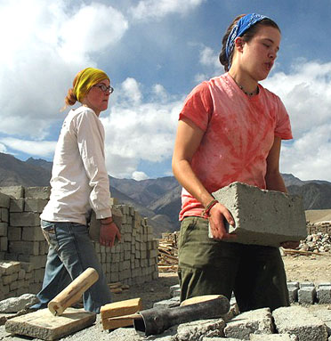
Hard-working

Slide 27
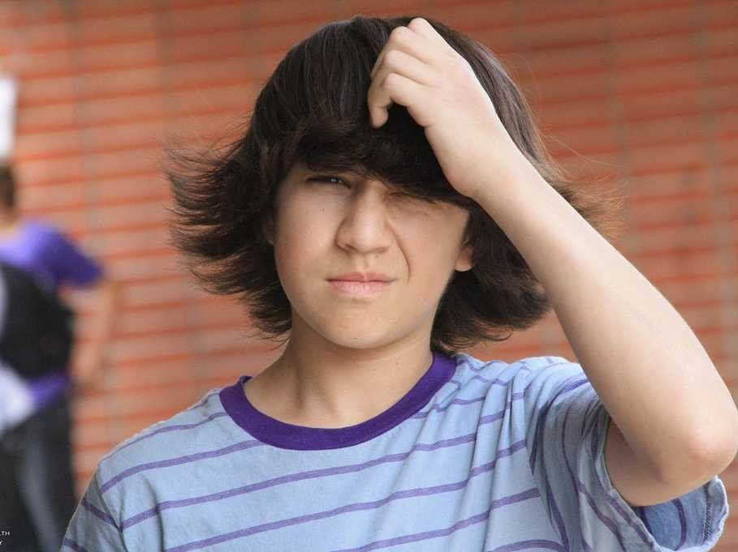
Hesitant

Slide 28
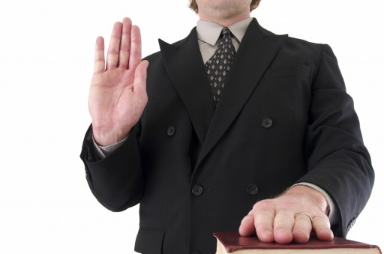
Honest

Slide 29
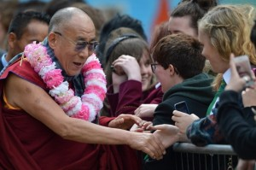
Humble

Slide 30
Immature

Slide 31
Impatient

Slide 32
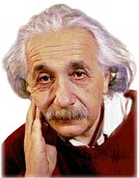
Intelligent

Slide 33
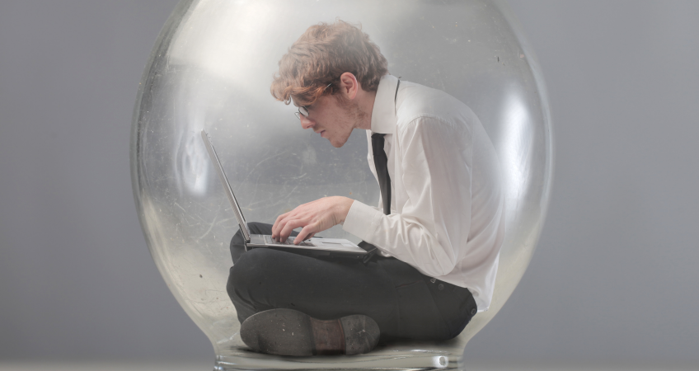
Introverted

Slide 34
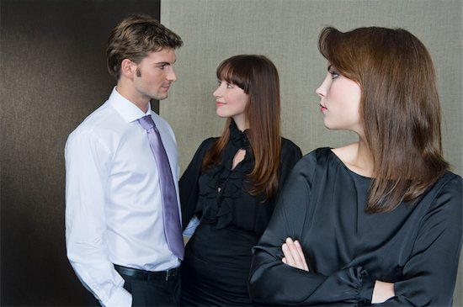
Jealous

Slide 35
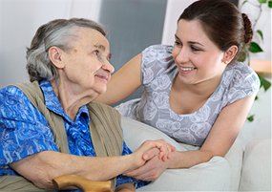
Kind

Slide 36
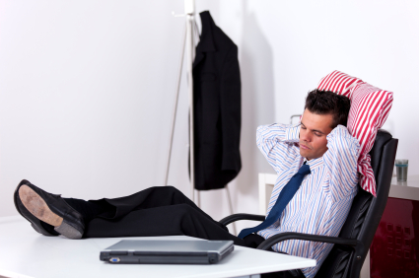
Lazy

Slide 37
Lively

Slide 38
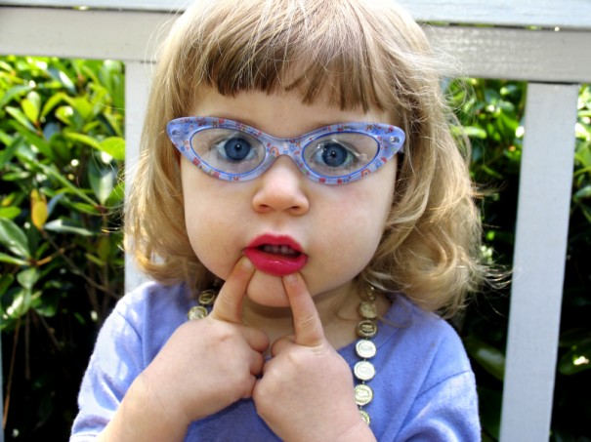
Mature

Slide 39
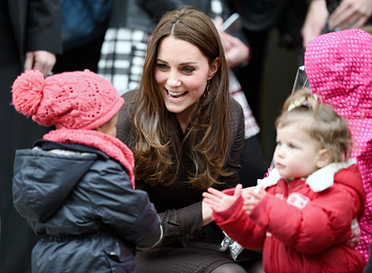
Modest

Slide 40
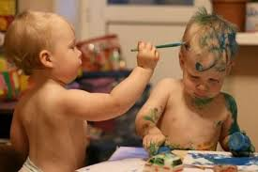
Naughty

Slide 41
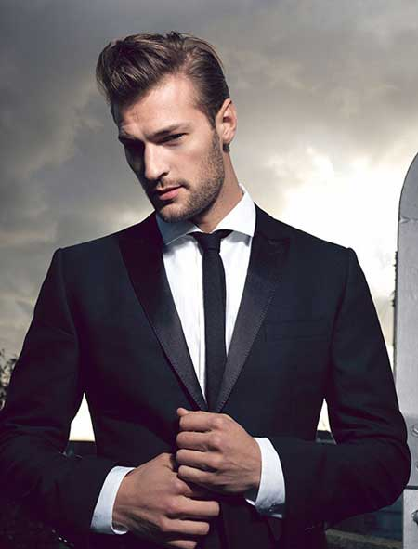
Neat
Notes:
Pulcro, arreglado

Slide 42
Nervous

Slide 43
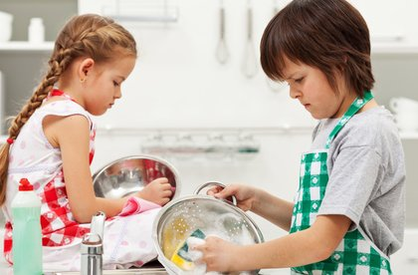
Obedient

Slide 44
Optimistic

Slide 45
Outgoing

Slide 46
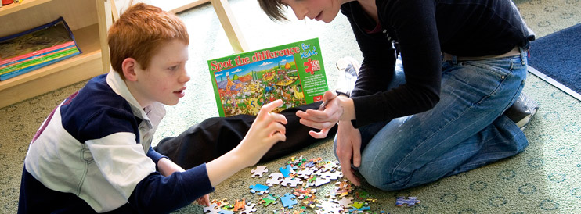
Patient

Slide 47
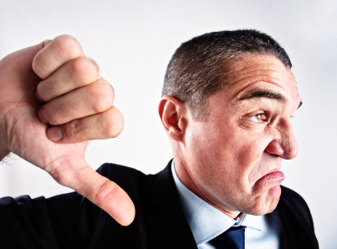
Pessimistic

Slide 48
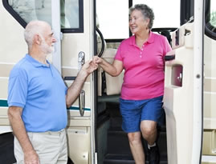
Polite

Slide 49
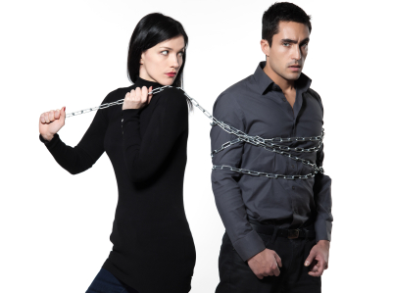
Possessive

Slide 50
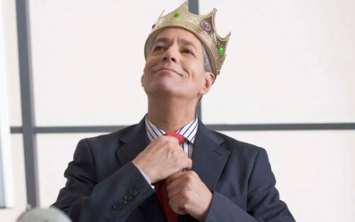
Proud

Slide 51
Quiet

Slide 52
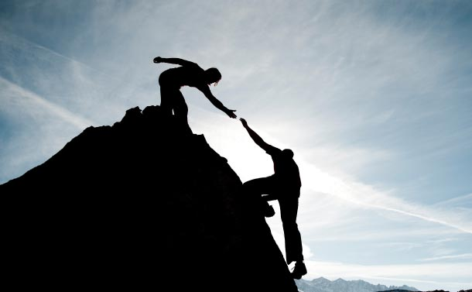
Reliable

Slide 53
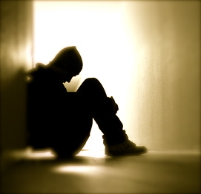
Reserved

Slide 54
Responsible

Slide 55
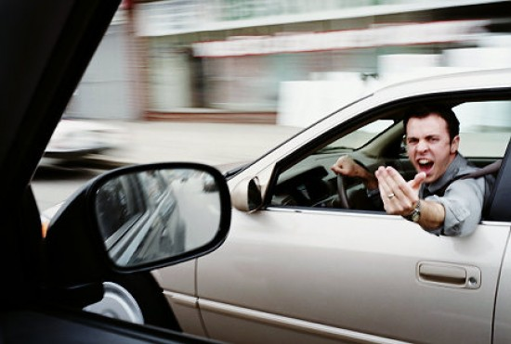
Rude

Slide 56
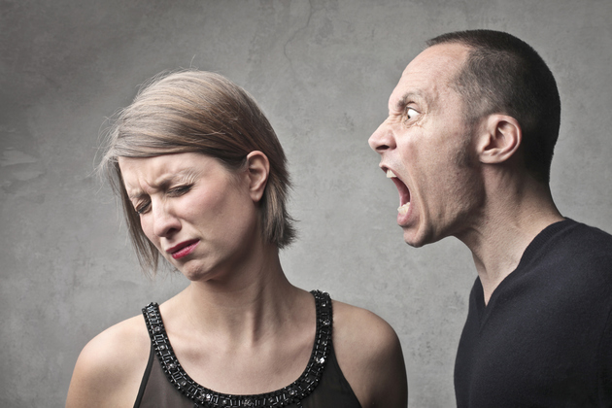
Ruthless
Notes:
Despiadado

Slide 57
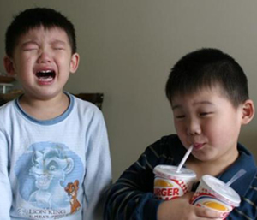
Selfish

Slide 58
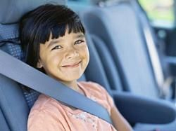
Sensible

Slide 59
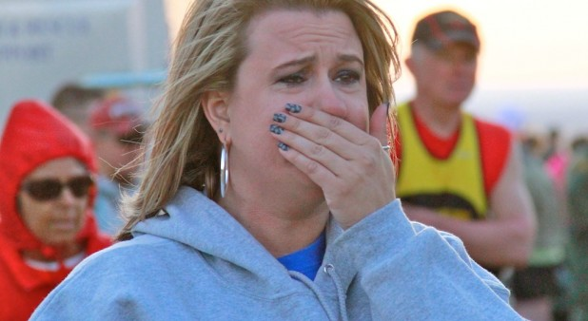
Sensitive

Slide 60
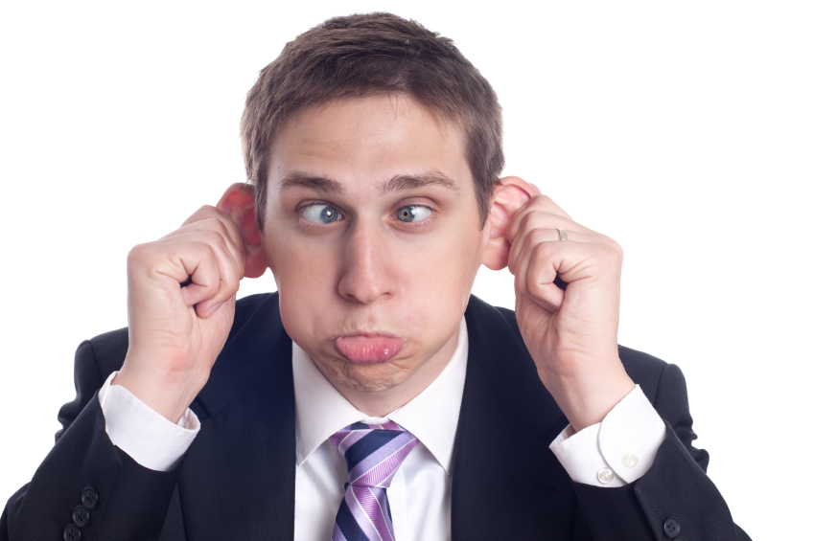
Silly

Slide 61
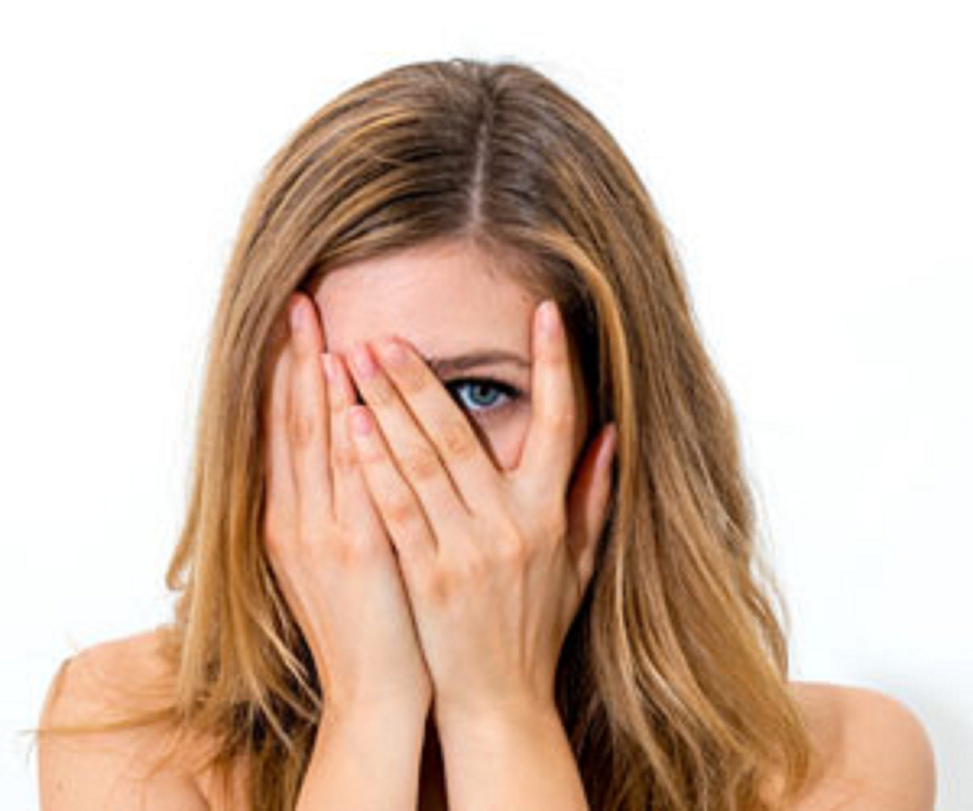
Shy

Slide 62
Strict

Slide 63
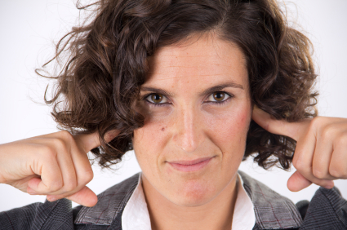
Stubborn

Slide 64
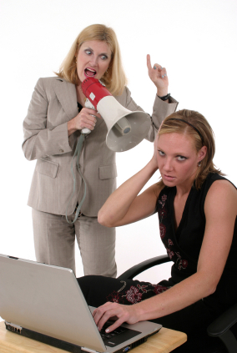
Talkative

Slide 65
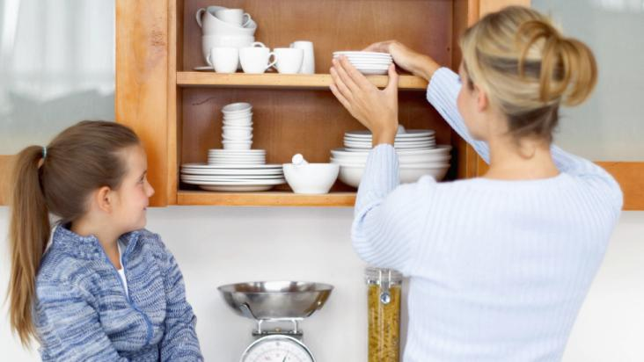
Tidy

Slide 66
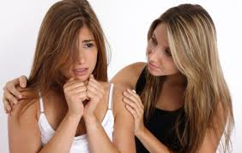
Touchy

Slide 67
Unfriendly

Slide 68
Unhappy

Slide 69
Unpleasant

Slide 70
Untidy

Slide 71
Witty

Slide 72
Present simple

Slide 73
AFFIRMATIVE
I am
You are
He is
She is
It is
We are
You are
They are
PRESENT TENSE

Slide 74
NEGATIVE
I’m not
You aren’t
He isn’t
She isn’t
It isn’t
We aren’t
You aren’t
They aren’t
PRESENT TENSE

Slide 75
INTERROGATIVE
Am I?
Are you?
Is he?
Is she?
Is it?
Are we?
Are you?
Are they?
PRESENT TENSE

Slide 76
Past simple

Slide 77
AFFIRMATIVE
I was
You were
He was
She was
It was
We were
You were
They were

Slide 78
NEGATIVE
I wasn’t
You weren’t
He wasn’t
She wasn’t
It wasn’t
We weren’t
You weren’t
They weren’t

Slide 79
INTERROGATIVE
Was I?
Were you?
Was he?
Was she?
Was it?
Were we?
Were you?
Were they?

Slide 80
ADJECTIVES
Write these adjectives in the most appropriate columm below.
usually positive | usually negative | could be either
 | absent-minded

Slide 81
CONVERSTATION QUESTIONS
PERSONALITY

Slide 82
PERSONALITY
What are you like?
What are some characteristics of your family’?
What makes you happy?
What are some things that make you angry?
Are you happy with your personality?
Would you like to be different?
Are you a determined person? Are you a stubborn person?
Are you shy? In which occasions are you shy?
Do you consider yourself selfish? Why (not)?

Slide 83
PERSONALITY
Is your personality suited to your job?
In what way has your personality changed? Why has it changed??
Are you more introverted (focused on your inner world) or more extrovert (focused on other people and the outer world)?
Do you think you can change a major characteristic of your personality if you try?
Do you think you have an unusual personality? Why?
If you could change any aspect of your personality, what would it be?
What sort of things would you do to amuse yourself during a car journey?
What personality traits do you consider important in a good friend / a boss / a partner?
Do you consider yourself to be good-tempered?
What is one thing that many people don't know about you?
Do you think birth order makes a difference in your personality?

