Slide 1
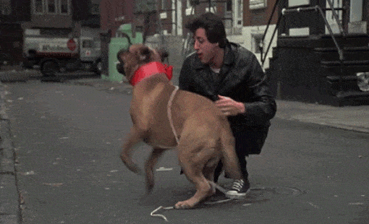
the first thing he did was go and get his dog back
The buyer blackmails him for $ 15,000 to get him back

Slide 2
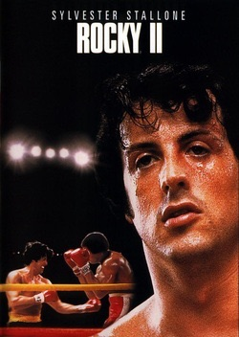
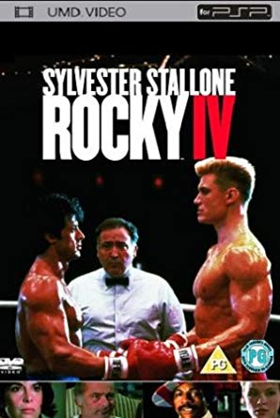
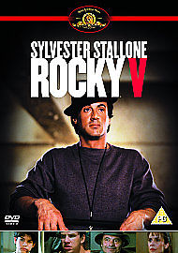
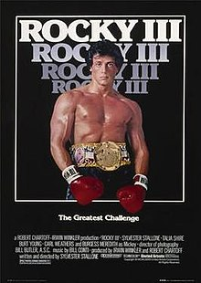
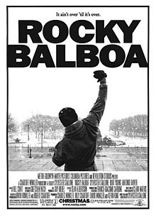
Rocky becomes the most successful film of the year. Nominated for 10 Oscar Awards and 3 wins.
Rocky has become one of the most successful series in cinema

Slide 3
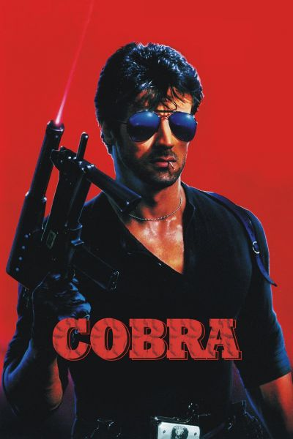
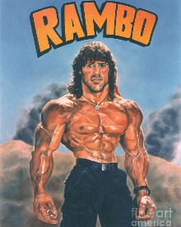
There are many series for the actor like:

Slide 4
Today, Sylvester, the one who slept on the streets, is one of the most successful actors of all time.

Slide 5
Made by:
Ivan Georgiev

