Slide 1
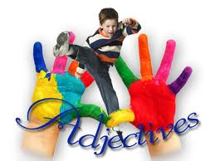
Adjectives Order

Slide 2
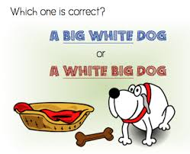

Slide 3
Opinion | silly, beautiful, horrible, difficult ,good,bad,ugly,smart ,dumb
Size | large, tiny, enormous, little,big,small,high,low
Age | ancient, new, young, old,antique
Shape | square, round, flat, rectangular,circular
Color | blue, pink, red, grey,purple,dark green,navy blue
Origin | French, lunar, American, Greek,Korean,Chinese,Italian
Material | wooden, metal, cotton, paper, iron,gold

Slide 5
OPINION | CONDITION | SIZE | AGE | COLOR | ORIGIN | MATERIAL | NOUN

Slide 7
1.a beautiful table (wooden/round)
A beautiful round wooden table.
2. an unusual ring (gold)
An unusual gold ring
3. a new jacket (nice)
A nice new jacket
4. an old house (beautiful)
A beautiful old house
5. black gloves(leather)
Black leather gloves

Slide 8
6. an American film(old)
7. a long face (thin)
8. big clouds (black)
9. a sunny day (lovely)
10. a wide avenue (long)
11.a metal box (black/small)
12.a big cat (fat/black)

Slide 9
13.a little village (old/ lovely)
14. long hair (black/beautiful)
15. an old painting (interesting/French)
16. an enormous umbrella (red/yellow)
18.city/a/Spanish/beautiful/old
19.arts/nice/teacher/French/our
20.green-eyed/gorgeous/black-haired/
a girl

Slide 10
1.Andrea had………………………..a in her hair yesterday.
a)nice yellow bow
b)yellow nice bow
c)bow nice yellow
2.The clown was wearing a …………… hat.
a)Big green yellow
b)Big green and yellow
c)Yellow and green big

Slide 11
3.I bought ……………… oranges.
a)Great some big
b)Big great some
c)Some great big
4.We met ……………… people at the conference.
a)very smart two
b) two very smart
c) very two smart

Slide 12
5.My uncle wore a ……………… to the wedding.
a)Silk blue tie
b)Tie blue silk
c)Blue silk tie
6.Have you met that ……………….. next door?
a)Cute boy new
b)Cute new boy
c)New cute boy

Slide 13
German / old / yellow / car
round / small / reading / lamp
German / old / yellow / car
wooden / huge / sailing / ship
physics / boring / old / teacher
slim / Canadian / handsome / snowboarder

Slide 14
sugar / blue / round / bowl

