Slide 1
My London best London Eye
by: Ognyan Chervarov

Slide 2
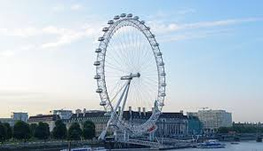
The destination in London I want to visit is London eye, because is a cantilevered observation wheel on the South Bank of the River Thames in London

Slide 3
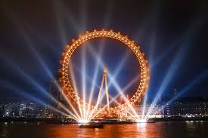
It is Europe's tallest cantilevered observation wheel, and is the most popular paid tourist attraction in the United Kingdom with over 3.75 million visitors annually.

Slide 4
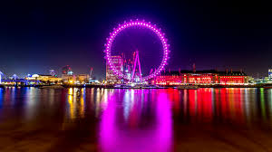
Design and construction
Supported by an A-frame on one side only, the Eye is described by its operators as a cantilevered observation wheel
The London Eye was designed by the husband-and-wife team of Julia Barfield and David Marks of Marks Barfield Architects

Slide 5
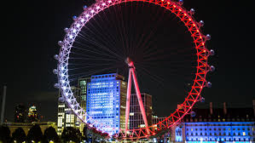
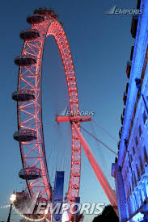
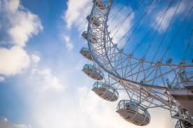
Nathaniel Lichfield and Partners assisted The Tussauds Group in obtaining planning and listed building consent to alter the wall on the South Bank of the Thames. They also examined and reported on the implications of a Section 106 agreement attached to the original contract, and also prepared planning and listed building consent applications for the permanent retention of the attraction, which involved the co-ordination of an Environmental Statement and the production of a planning supporting statement detailing the reasons for its retention

Slide 6
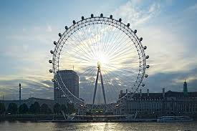
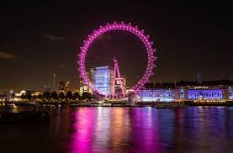
Opening
The London Eye was formally opened by the Prime Minister Tony Blair on 31 December 1999, but did not open to the paying public until 9 March 2000 because of a capsule clutch problem. The London Eye was originally intended as a temporary attraction, with a five-year lease. In December 2001, operators submitted an application to Lambeth Council to give the London Eye permanent status, and the application was granted in July 2002.On 5 June 2008 it was announced that 30 million people had ridden the London Eye since it opened.

Slide 7
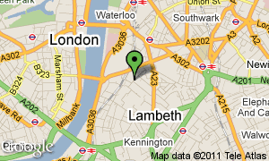
Placement
The London Eye is situated on the South Bank of the river Thames, opposite the Houses of Parliament. The ticket office is located inside County Hall, which is the building directly next to the London Eye.

Slide 8
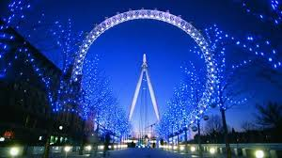
Work time
Monday – 10.00/ 18.30
Tuesday – 10.00/ 18.30
Wednesday – 10.00/ 18.30
Thursday – 10.00/ 18.30
Friday – 10.00/ 18.30
Saturday – 09.30/ 19.00
Sunday – 09.30/ 19.00

