Slide 1
My London Best
PREPARED: Dimitar Lyupev 8d class

Slide 2
London is an amazing city. I like this city because all the stories I have heart for this town are very interesting. I want to go there some day because I want to visit some places which are famous all around the world. I will show you two places in London which I want to visit some day.

Slide 3
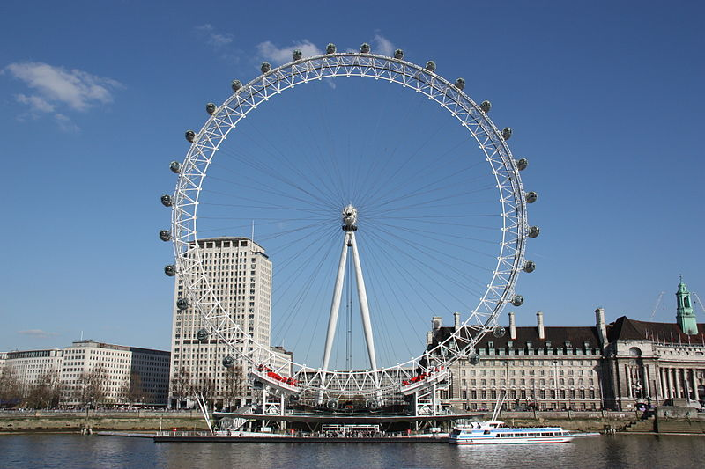
The London Eye

Slide 4
The London Eye is the most popular paid tourist attraction in the United Kingdom with over 3.75 million visitors annually and has made many appearances in popular culture. And I think it is the most romantic place in the world. That’s why I like this attraction.

Slide 5
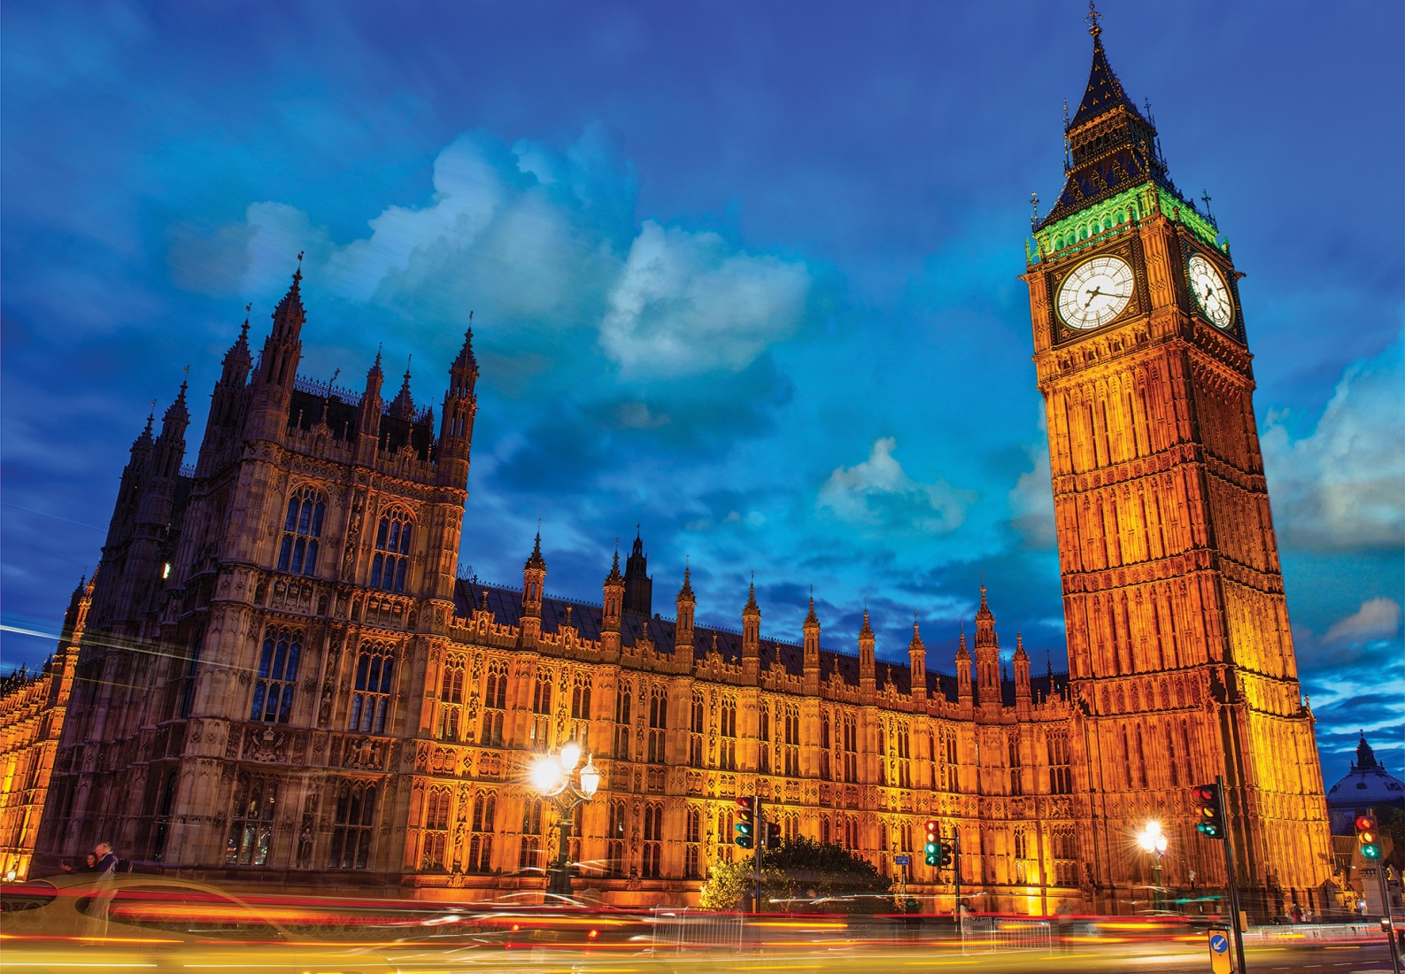
Big Ben

Slide 6
Big Ben (also know as “Elizabeth Tower”) is one of the most popular sights in London. I want to visit it because it is the largest and most accurate four-faced clock in the world. The sight is very interesting. It’s huge and one of the most memorial symbols of London. It will be honor for me to visit it.

Slide 7
I HOPE IT WAS INTERESTING FOR YOU THANK YOU FOR THE ATTENTION

