Slide 1
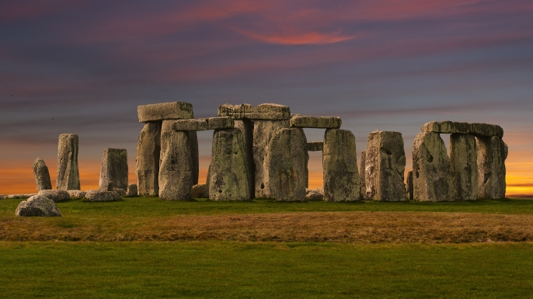
Stonehenge

Slide 2
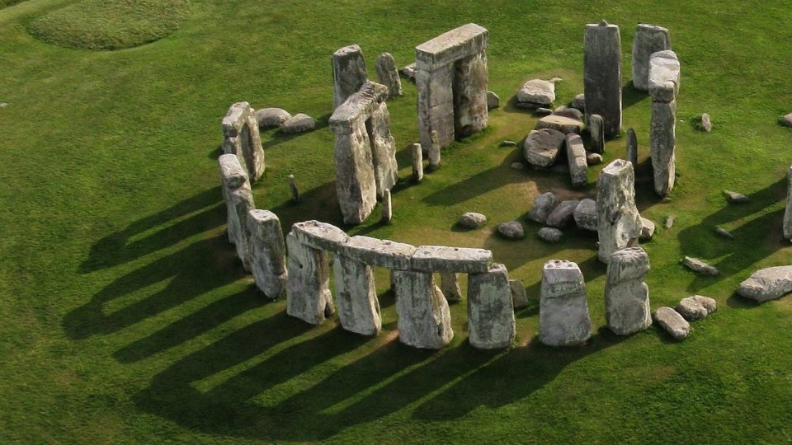
Stonehenge is a prehistoric monument in Wiltshire, England, 2 miles (3 km) west of Amesbury and 8 miles (13 km) north of Salisbury. Stonehenge's ring of standing stones are set within earthworks in the middle of the most dense complex of Neolithic and Bronze Age monuments in England, including several hundred burial mounds.

Slide 3
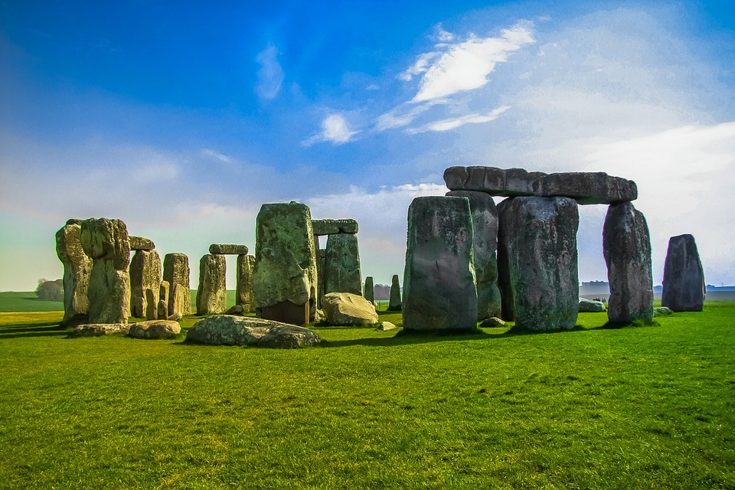
Before the monument (8000 BC forward)
Archaeologists have found four, or possibly five, large Mesolithic postholes (one may have been a natural tree throw), which date to around 8000 BC, beneath the nearby modern tourist car-park. These held pine posts around 0.75 metres (2 ft 6 in) in diameter, which were erected and eventually rotted in situ. Three of the posts (and possibly four) were in an east-west alignment which may have had ritual significance.

Slide 4
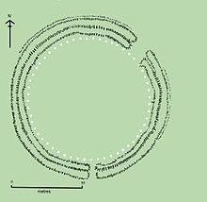
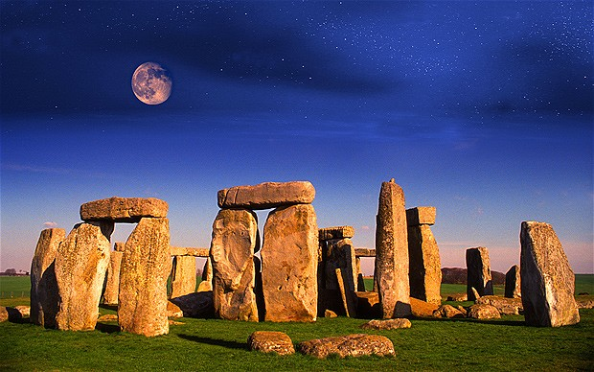
Stonehenge 1 (ca. 3100 BC)
The first monument consisted of a circular bank and ditch enclosure made of Late Cretaceous ( Santonian Age) Seaford Chalk, measuring about 110 metres (360 ft) in diameter, with a large entrance to the north east and a smaller one to the south. It stood in open grassland on a slightly sloping spot

Slide 5
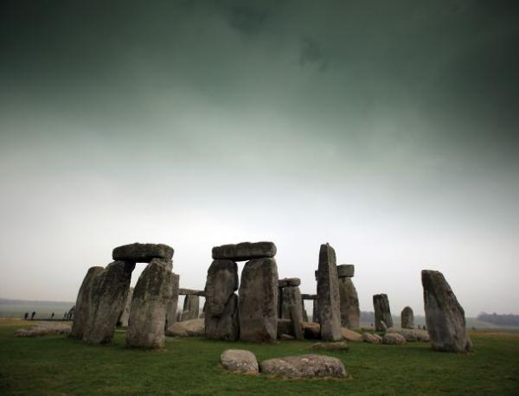
Stonehenge 2 (ca. 3000 BC)
Evidence of the second phase is no longer visible. The number of postholes dating to the early 3rd millennium BC suggest that some form of timber structure was built within the enclosure during this period. Further standing timbers were placed at the northeast entrance, and a parallel alignment of posts ran inwards from the southern entrance. The postholes are smaller than the Aubrey Holes, being only around 0.4 metres (16 in) in diameter, and are much less regularly spaced.

Slide 6
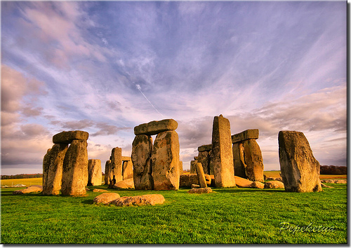
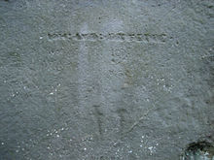
Stonehenge 3 I (ca. 2,600 BC)
Archaeological excavation has indicated that around 2600 BC, the builders abandoned timber in favour of stone and dug two concentric arrays of holes (the Q and R Holes) in the centre of the site. These stone sockets are only partly known (hence on present evidence are sometimes described as forming 'crescents'); however, they could be the remains of a double ring.

Slide 7
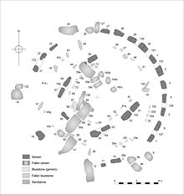
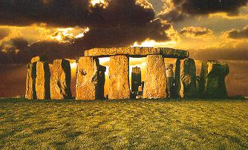
Stonehenge 3 II (2600 BC to 2400 BC)
During the next major phase of activity, 30 enormous Oligocene-Miocene sarsen stones (shown grey on the plan) were brought to the site. They may have come from a quarry around 25 miles (40 km) north of Stonehenge on the Marlborough Downs, or they may have been collected from a "litter" of sarsens on the chalk downs, closer to hand. The stones weredressed and fashioned with mortise and tenon joints before 30 were erected as a 33 metres (108 ft) diameter circle of standing stones, with a ring of 30 lintel stones resting on top.

Slide 8
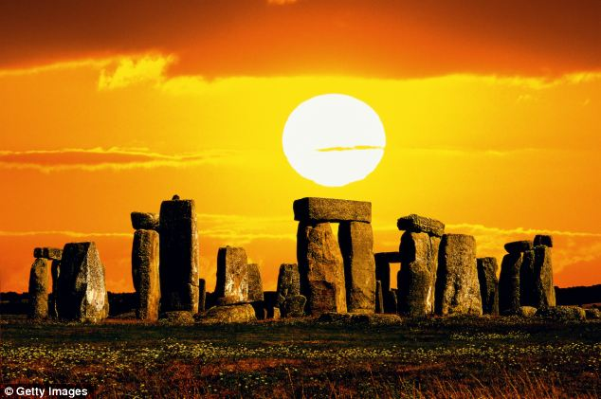
Stonehenge 3 III (2400 BC to 2280 BC)
Later in the Bronze Age, although the exact details of activities during this period are still unclear, the bluestones appear to have been re-erected. They were placed within the outer sarsen circle and may have been trimmed in some way.

Slide 9
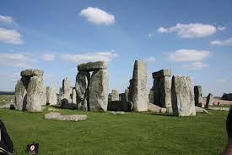
Stonehenge 3 V (1930 BC to 1600 BC)
Soon afterwards, the north eastern section of the Phase 3 IV bluestone circle was removed, creating a horseshoe-shaped setting (the Bluestone Horseshoe) which mirrored the shape of the central sarsen Trilithons. This phase is contemporary with the Seahenge site in Norfolk.

Slide 10
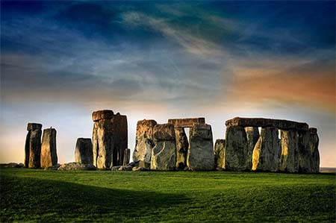
After the monument (1600 BC on)
The Y and Z Holes are the last known construction at Stonehenge, built about 1600 BC, and the last usage of it was probably during the Iron Age. Roman coins and medieval artefacts have all been found in or around the monument but it is unknown if the monument was in continuous use throughout British prehistory and beyond, or exactly how it would have been used.

