Slide 1
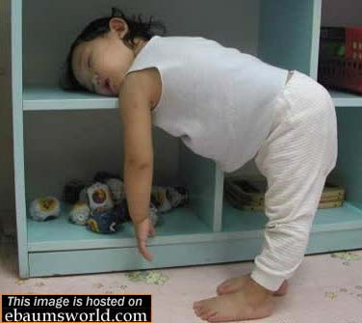
A
D
V
I
C
E
I am so tired! What should I do?

Slide 2
Giving Advice
You could…
Why don’t you...
How about…
Maybe you should...
I think you should…
Why not…
If I were you, I would…

Slide 3
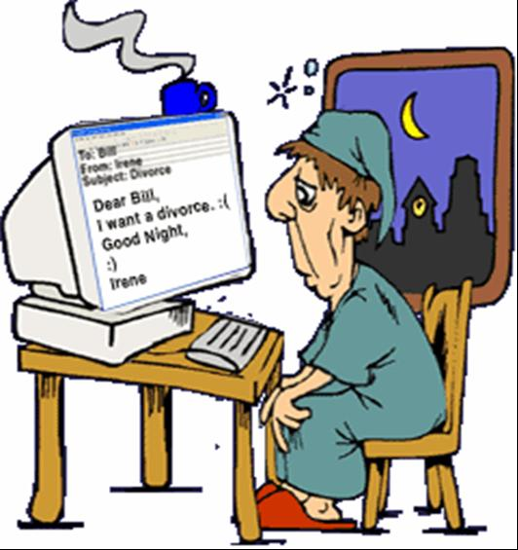
The man is very
tired
His wife is angry
because he works
too much!
Any Advice???

Slide 4
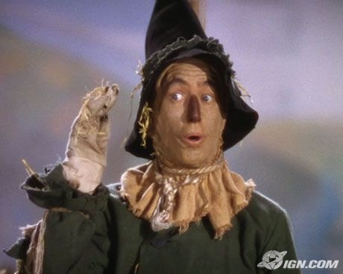
He doesn’t have a brain.
He is very stupid.

Slide 5
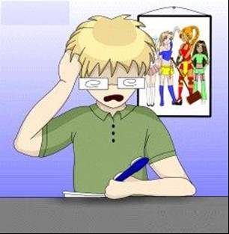
The boy has a difficult exam
tomorrow
He has not started studying
yet

Slide 6
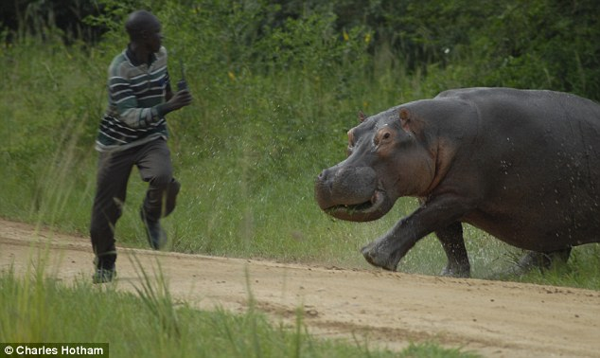
He is being chased by a hippo.
The hippo is very angry!

Slide 7
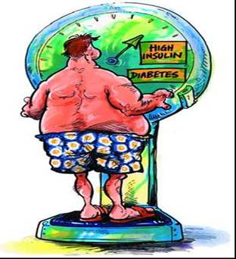
The man is too fat
He loves donuts and pizza
His doctor says he is sick

Slide 8
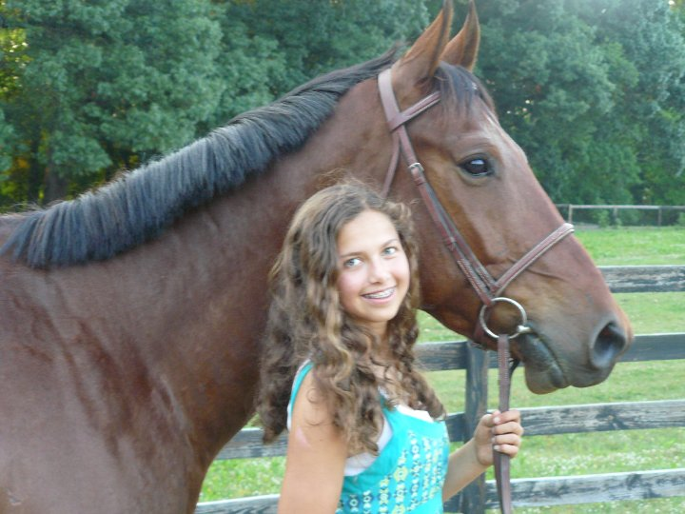
She is very hungry.
She has no food and no money.

Slide 9
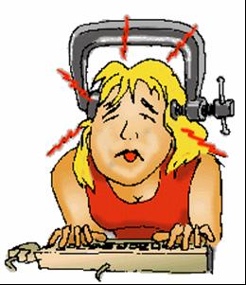
The woman feels so much
pain
She has a terrible headache
She needs to finish her
computer work.

Slide 10
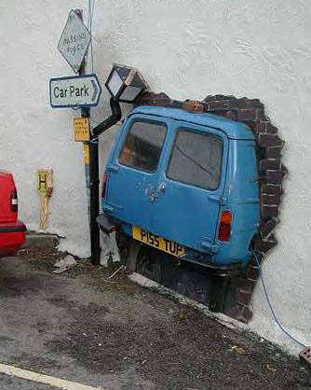
I am a bad driver.
I always get in car accidents.

Slide 11
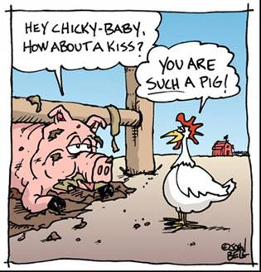
The pig is so dirty!
The pig wants to kiss the duck
The duck does NOT
like dirty pigs

Slide 12
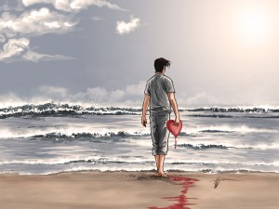
He has a broken heart.
He is lonely.

Slide 13
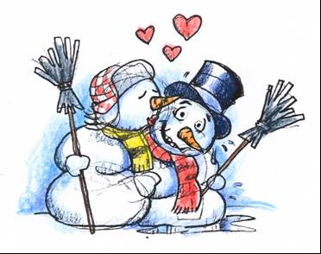
It’s so cold today
They do not have jackets
They have no money.

Slide 14
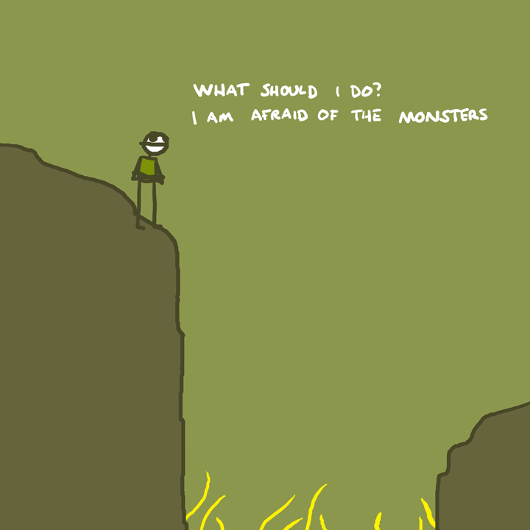
He wants to get across.
He is afraid.

Slide 15
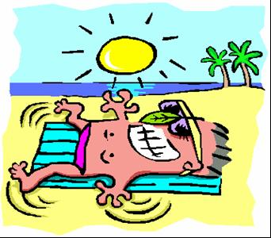
The man is very sun burnt
He does not have sun
cream

