Slide 1
ENGLAND

Slide 2
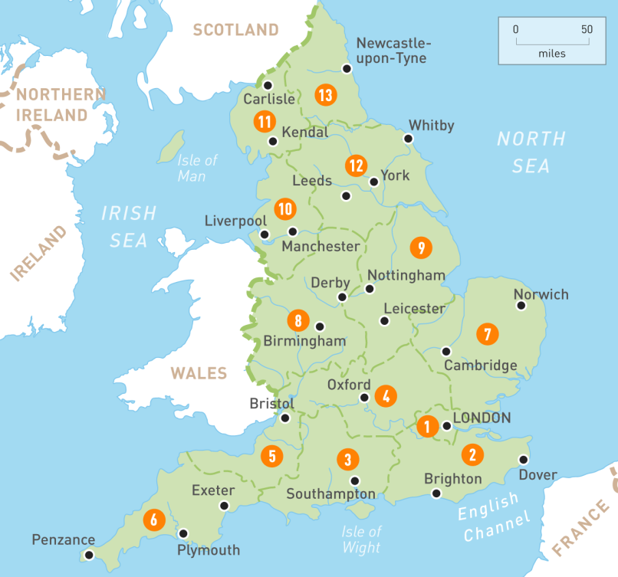
Geographic location and borders
England is a country that is part of the United Kingdom. It shares land borders with Scotland to the north and Wales to the west. The Irish Sea lies northwest of England and the Celtic Sea lies to the southwest. England is separated from continental Europe by the North Sea to the east and the English Channel to the south. The country covers five-eighths of the island of Great Britain (which lies in the North Atlantic) in its centre and south; and includes over 100 smaller islands such as the Isles of Scilly, and the Isle of Wight.
Map of the United Kingdom
Wales
Ireland
Scotland

Slide 3
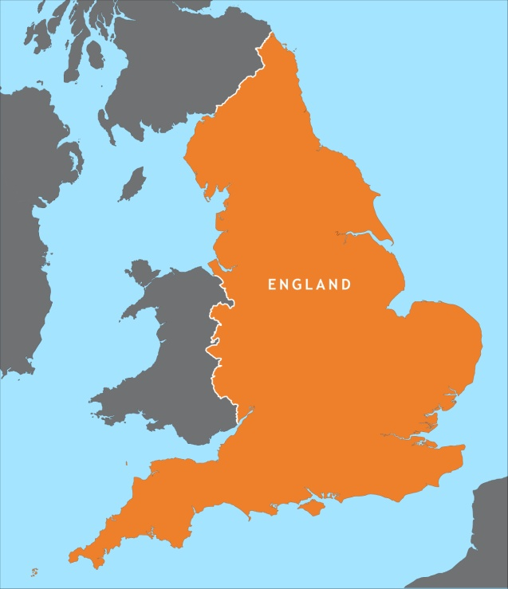
Area and Population
England's terrain mostly comprises low hills and plains, especially in central and southern England. However, there are uplands in the north (for example, the mountainous Lake District, and the Pennines) and in the southwest (for example, Dartmoor and the Cotswolds). The capital is London, which is the largest metropolitan area in both the United Kingdom and the European Union. England's population of over 53 million comprises 84% of the population of the United Kingdom, largely concentrated around London, the South East, and conurbations in the Midlands, the North West, the North East, and Yorkshire, which each developed as major industrial regions during the 19th century.

Slide 4
History of England
The end of Roman rule in Britain facilitated the Anglo-Saxon settlement of Britain, which historians often regard as the origin of England and of the English people. The Anglo-Saxons, a collection of various Germanic peoples, established several kingdoms that became the primary powers in present-day England and parts of southern Scotland. They introduced the Old English language, which largely displaced the previous British language. The Anglo-Saxons warred with British successor states in Wales, Cornwall, and the Hen Ogledd as well as with each other. Raids by Vikings became frequent after about AD 800, and the Norsemen settled in large parts of what is now England. During this period, several rulers attempted to unite the various Anglo-Saxon kingdoms, an effort that led to the emergence of the Kingdom of England by the 10th century.

Slide 5
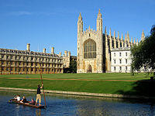
Education of England
Higher education students normally attend university from age 18 onwards, where they study for an academic degree. There are over 90 universities in England, all but one of which are public institutions. Students are generally entitled to student loans to cover the cost of tuition fees and living costs. The first degree offered to undergraduates is the Bachelor's degree, which usually takes three years to complete. Students are then able to work towards a postgraduate degree.
King's College, University of Cambridge

Slide 6
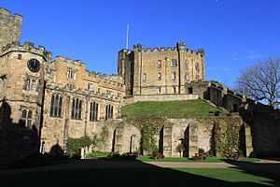
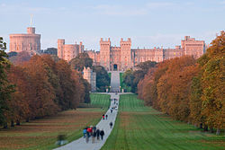
Culture of England
After the Norman conquest in 1066 various Castles in England were created so law lords could uphold their authority and in the north to protect from invasion. Some of the best-known medieval castles are the Tower of London, Warwick Castle, Durham Castle and Windsor Castle.
Durham Castle
Windsor Castle

Slide 7
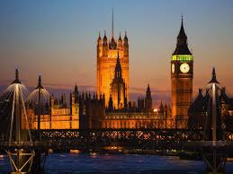
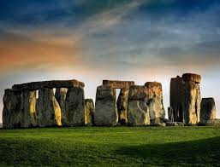
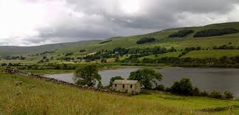
Famous attractions in England
Big Ben
Stonehenge
Yorkshire dales

Slide 8
Thanks for your attention! Presentation by daniel videlov 8a class

