Slide 1
Comparative
or
Superlative
Make three sentences
for each picture

Slide 2
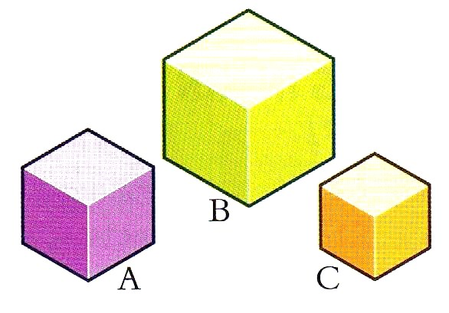
A is bigger than B.
B is the biggest.
C is the smallest.
big/small

Slide 3
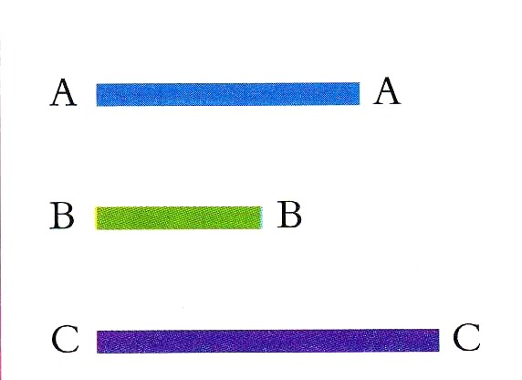
A is longer than B.
B is the shortest.
C is the longest.
long/short

Slide 4
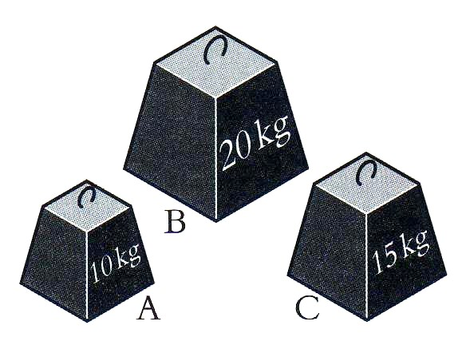
A is the lightest.
B is the heaviest.
C is lighter than B.
heavy/light

Slide 5
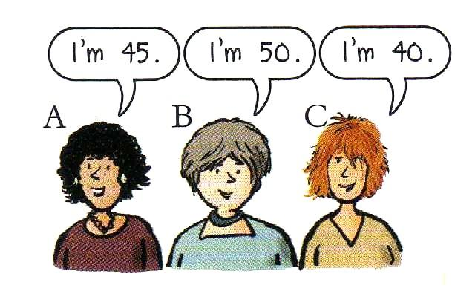
A is younger than B.
B is the oldest/eldest.
C is younger than B.
old/young

Slide 6
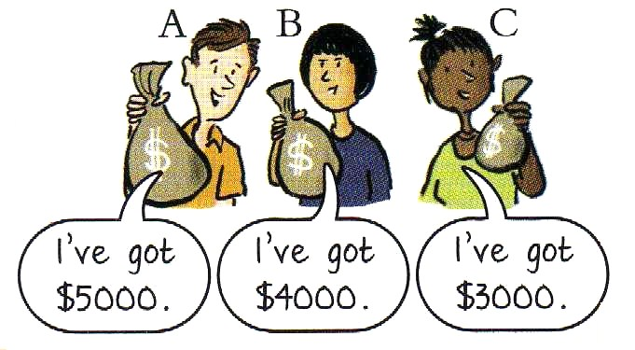
A has got the most money.
B has got more money than C.
C has got less money than B.
more/less
money

Slide 7
Complete
the
sentences

Slide 8
is longer than
C………………………….A.
D………………………………
B…………………………………
is the longest
is the shortest

Slide 9
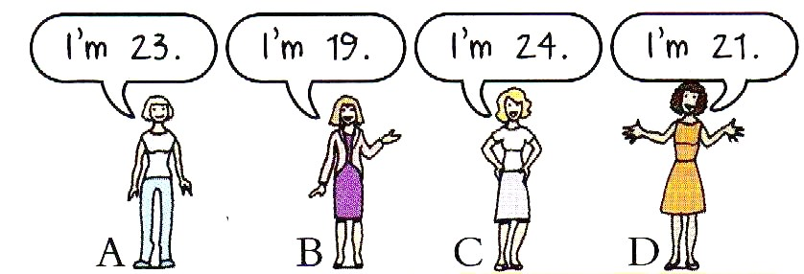
is younger than
D………………………….C.
B………………………………
C…………………………………
is the youngest
is the oldest

Slide 10
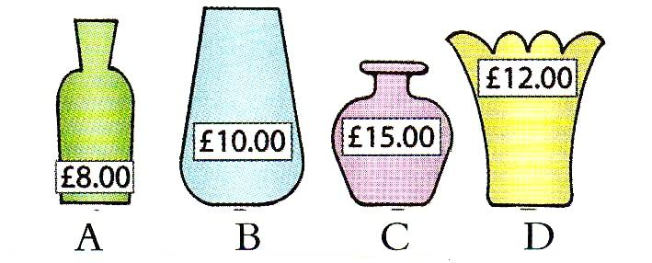
is more expensive than
D……………………………………….A.
C………………………………
A……………………………
is the most expensive
is the cheapest

Slide 11
is better than
A…………………………….C.
A………………………………
D……………………………
is the best
is the worst

