Slide 1
Cambridge
Presented by Simeon Apostolov

Slide 2
Cambridge is auniversity city and the county town of Cambridgeshire, England, on the River Cam about 50 miles (80 km) north of London. At theUnited KingdomCensus 2011, its population was 123,867, including 24,488 students.

Slide 3
The University of Cambridge, founded in 1209, is one of the top five universities in the world. The university includes theCavendish Laboratory, King`s College Chapel, and the Cambridge University Library.Anglia Ruskin University, formed from the Cambridge School of Art and the Cambridgeshire College of Arts and Technology, also has its main campus in the city.

Slide 4
Culture
Cambridge's main traditional theatre is the Arts theatre, a venue with 666 seats in the town centre. The Fitzwilliam Museum is the city's largest, and is the lead museum of the University of Cambridge Museums. Founded in 1816 from the bequeathment and collections of Richard Viscount, Fitzwilliam the museum was originally located in the building of the Perse Grammar School in Free School Lane.

Slide 5
Cambridge's two universities, the collegiateUniversity of Cambridgeand the local campus of Anglia Ruskin University, serve around 30,000 students, by some estimates.Cambridge University estimated its 2007/08 student population at 17,662,and Anglia Ruskin reports 24,000 students across its two campuses (one of which is outside Cambridge, in Chelmsford for the same period.

Slide 6
Music
Pink Floyd are the most notable band with roots in Pink Floyd are the most notable band with roots in Cambridge. The band's former songwriter, guitarist and vocalist Syd Barrett was born and lived in the city, and he and another founding member, Roger Waters, went to school together at Cambridgeshire High School for Boys. David Gilmour, the guitarist who replaced Barrett, was also a Cambridge resident and attended the nearby Perse School.ambridge.

Slide 7
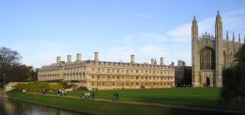
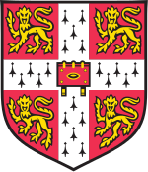
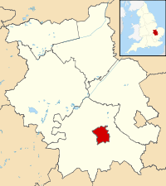
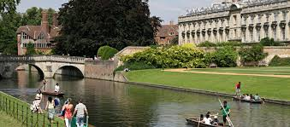

Slide 8
THE END
thank you for watching

